Slide 1

From Risk to Resilience
Leveraging disaster risk reduction for national auditing
23rd INTOSAI Working Group on Environmental Auditing (WGEA) Assembly
1 – 3 July 2025, Malta
@animesh00
@undrr

Slide 2
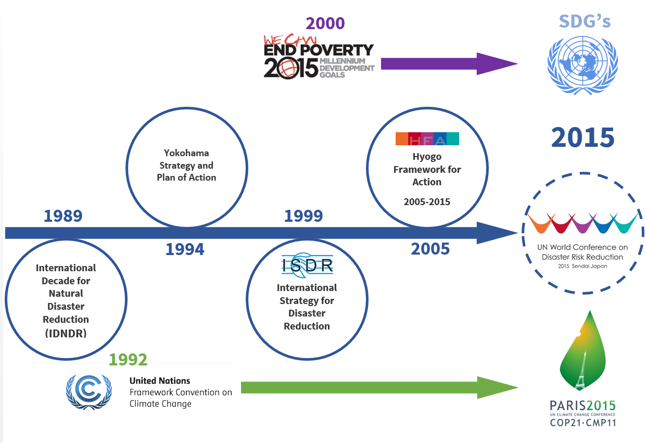
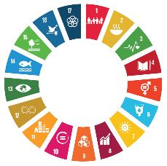

30 years of global development and risk governance
Pre-1970s: AD-HOC DISASTER RESPONSE
1970s-1990s: HUMANITARIAN ARCHITECTURE
PREPAREDNESS-CENTRIC DRR
RISK-INFORMED
SUSTAINABLE DEVELOPMENT
Resilience as a common denominator
SDGs

Slide 3


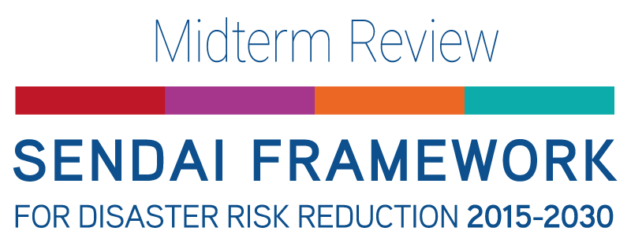
Challenge: Stocktake after 10 years
Global Stocktake
Offtrack to achieving goal, with increasing impact from climate and weather-related events
Recognized siloed approaches that limit integration of risks
Not on track in fulfilling its objective
Fragmented, incremental, sectoral and unequal adaptation action
Offtrack:
Only 17% of SDG targets are on track to be achieved by 2030.
Nearly half show minimal or moderate progress
Over one-third are stalled or regressing

Slide 4
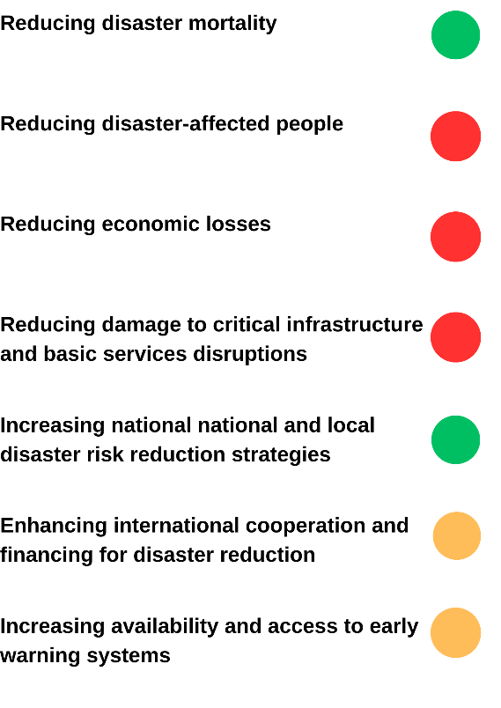
Challenge: Growing disaster risk
Since 2015
Over 40k deaths and 120 million affected per year
Direct economic losses over $ 200 billion annually
Direct and indirect (including cascading and ecosystems costs) – over 10 times more ($2.3 trillion)
Over 850k critical infrastructure units damaged or destroyed
Mortality in LDCs, LLDCs and SIDS is at least twice compared to global average.
Disaster-related economic losses in LDCs are over six times the global average

Slide 5
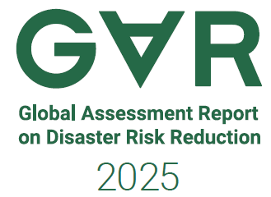
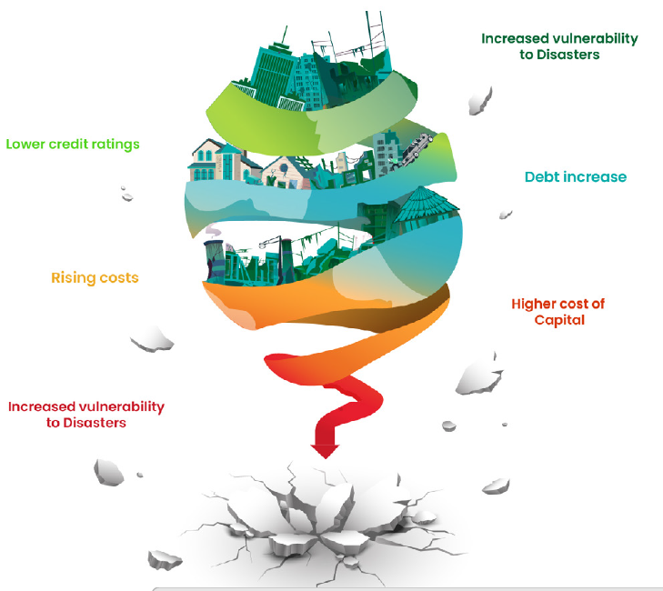
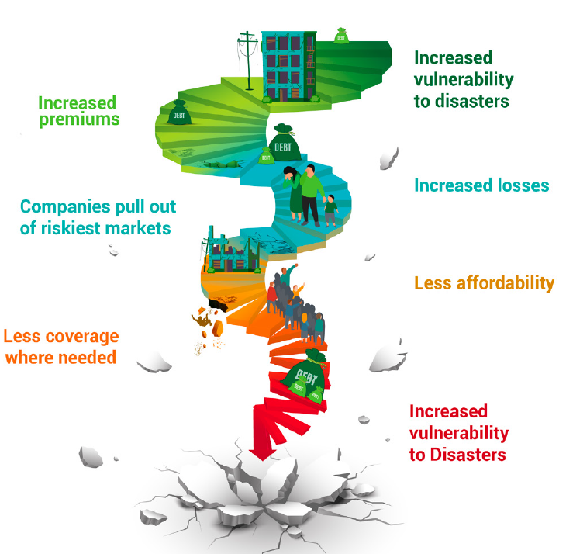
Challenge: The risk spiral
The spiral of decreasing income, increasing debt
The spiral of unsustainable risk transfer

Slide 6
Strengthening national auditing through DRR
Financial Audit
Economic cost of disasters
Performance Audit
Compliance Audit
Auditing risk-based measures in development planning
Financial performance of DRR investments to reduce disaster risk and impact of climate change
Shift from reactive crises management to proactive risk management
Impact of disasters on financial statements to be considered, where relevant
UNGA Resolution on SAIs [A/RES/79/231, Dec 2024]
Role of SAIs in addressing climate change through independent and objective assessments of national actions, fostering the efficient allocation of resources, assessing policy effectiveness
Encourages Member States to consider climate-related findings and recommendations in SAI reports.

Slide 7
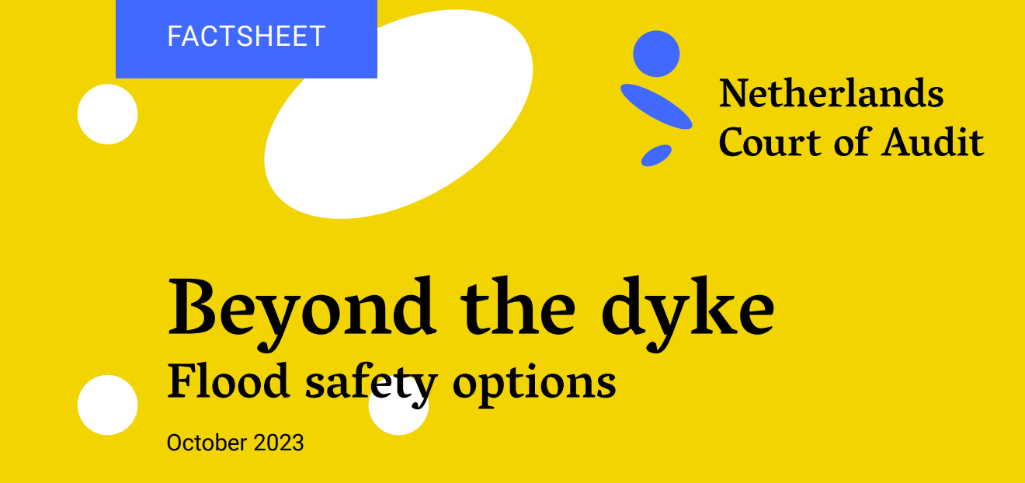
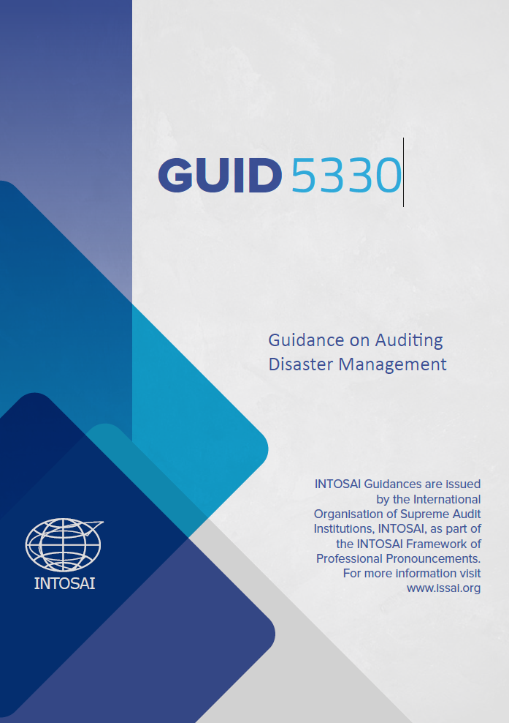
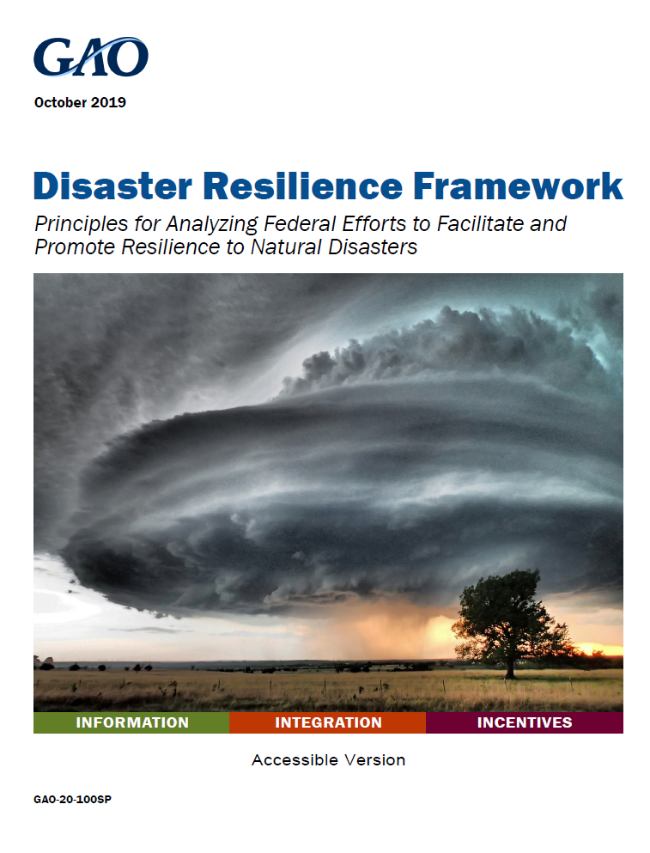
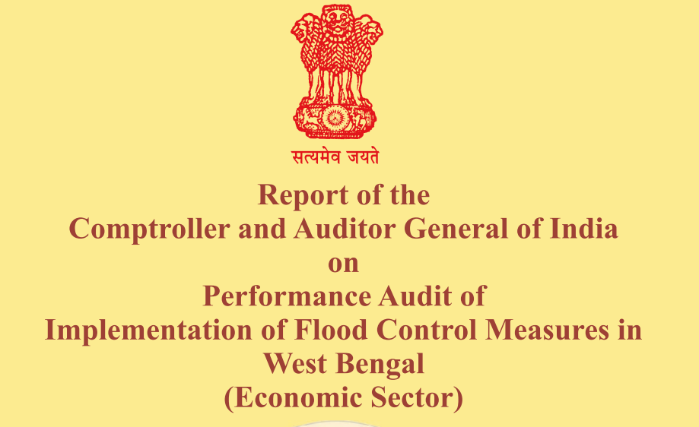
Strengthening DRR through national auditing

Slide 8
Emerging opportunities
The Geneva Call for Disaster Risk Reduction
…engaging national supreme audit institutions and independent oversight bodies enhance transparency and accountability…
Priority should be given to ensuring predictable and annual financial allocations in national and local budgets for investments in risk prevention and reduction. National Supreme Audit Institutions are important partners in these critical efforts.

Slide 9
Climate action and DRR: Better synergy
Progress Review
Global Stocktake of the Paris Agreement
Midterm Review of the Sendai Framework
Adaptation
Global Goal on Adaptation &
National Adaptation Plans
Loss & Damage
Santiago network
Fund for Responding to Loss & Damage
Data & Early Warnings
Adaptation & Loss & damage data
Early Warnings for All
Executive Committee of the Warsaw International Mechanism
UNDRR supporting development of GGA indicators
National DRR strategies
UNDRR as co-host of SN and active in L&D space

Slide 10
Climate action and DRR: Global Goal on Adaptation
Water supply and sanitation
Ecosystems & biodiversity
Infrastructure and human settlements
Poverty eradication and livelihoods
Cultural heritage and knowledge
Health impacts and health services
Food and agricultural production
Adaptation Cycle targets
Impact, vulnerability and risk assessment
Planning
Implementation
Monitoring, evaluation & learning
Thematic Targets
Official indicators on adaptation
~ 10,000
Current ~500
Final 100

Slide 11
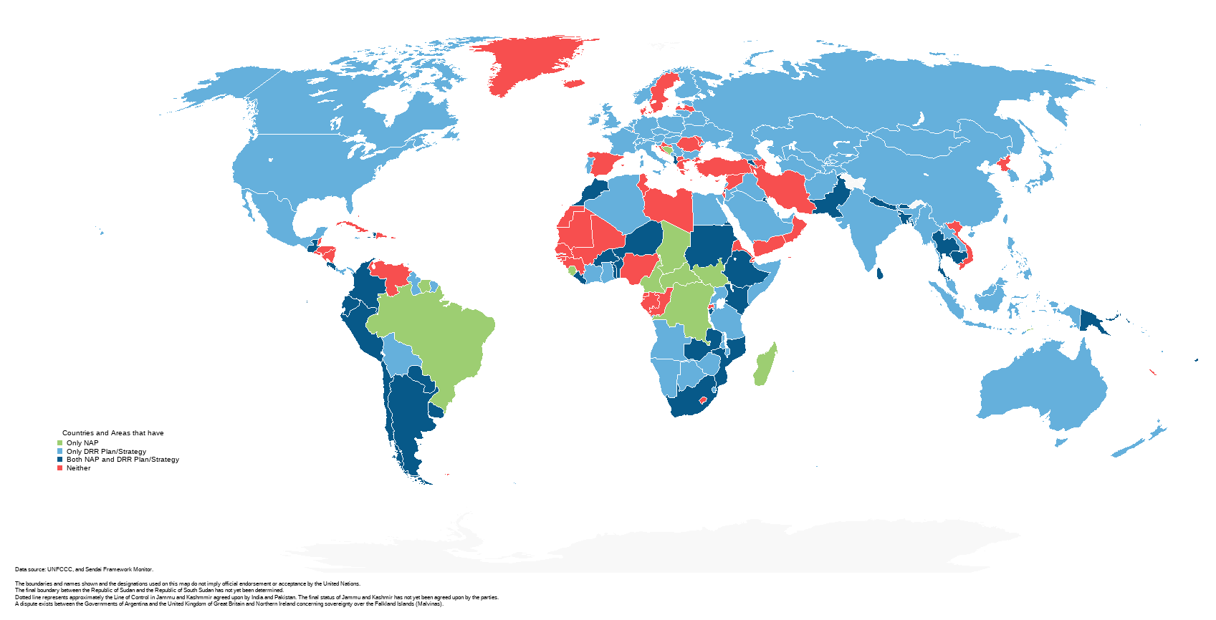
POLICY: Integrated planning for coherent implementation
undrr.org/crm
THE POLICY IMPERATIVE
Co-create
Expand
Co-implement

Slide 12

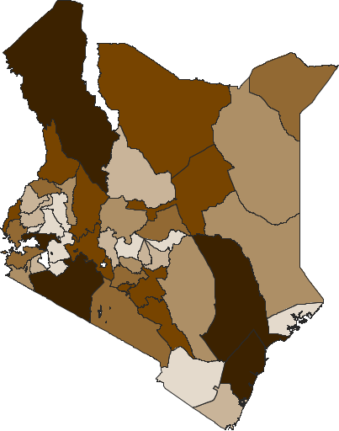
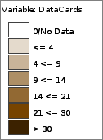
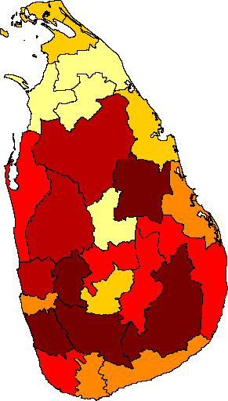
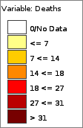
Data: Key enabler of risk disclosure
Frequency of floods in Kenya
The next-generation disaster tracking system for hazardous events and losses and damages
www.desinventar.net
undrr.org/L-DTracking
113 countries
with L&D databases
Official data
Enhanced levels of data disaggregation
  Hazards
  Geographic
  Socio-economic
Robust data standards and methods
Integrated system for both hazardous events and disaster impacts
Deaths due to lightening strikes in Sri Lanka

Slide 13
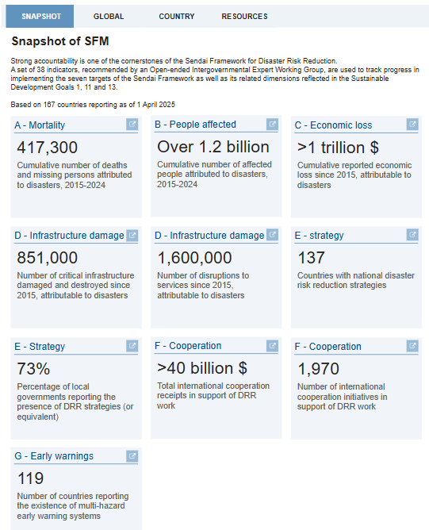
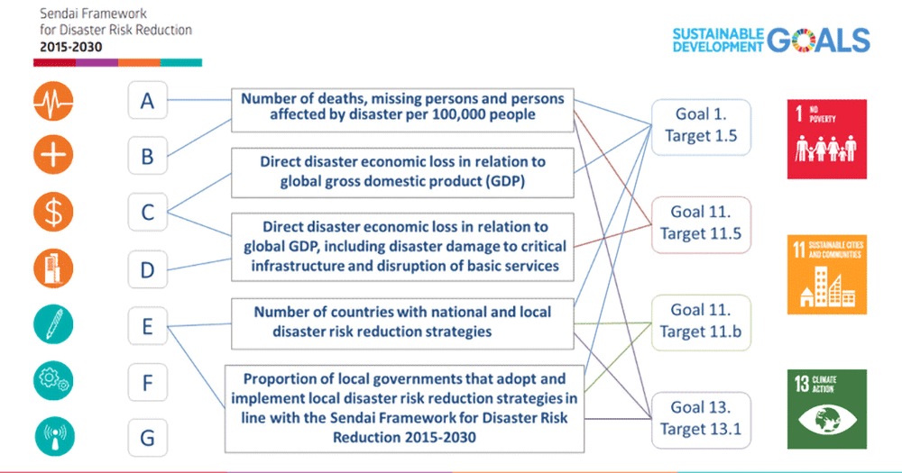

Data: Monitoring of Sendai Framework and SDGs
undrr.org/SFM
167 countries reporting on Sendai Framework Monitor
2/3rd of countries have reported on SDG-related targets
Only 50% have ever reported on all seven targets

Slide 14
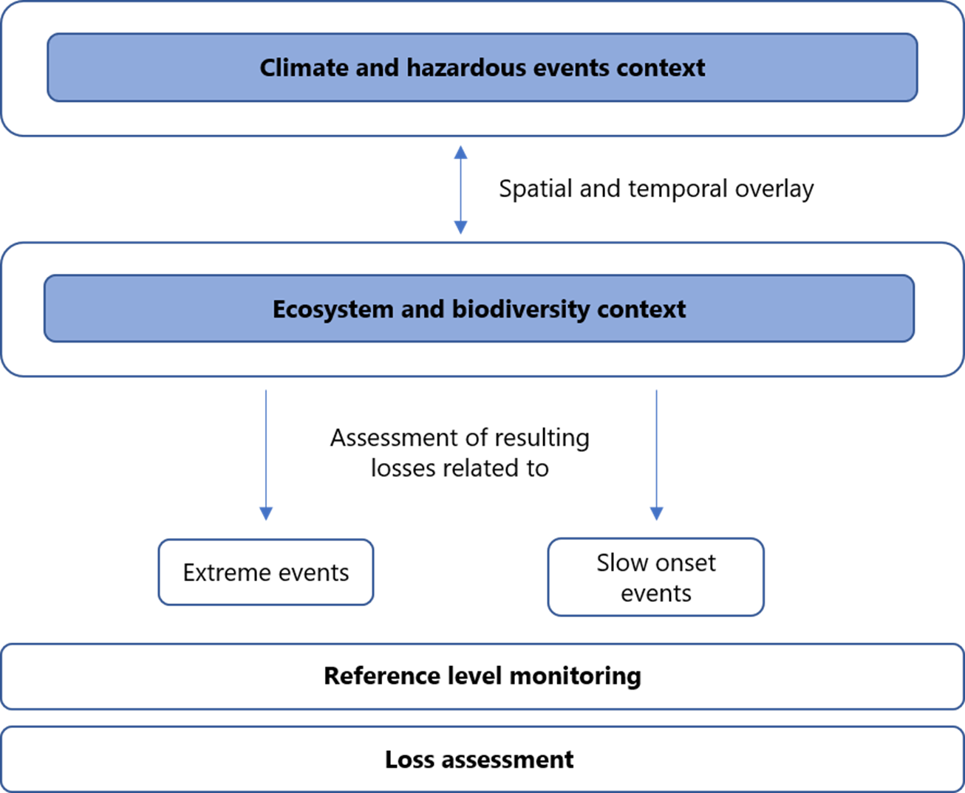
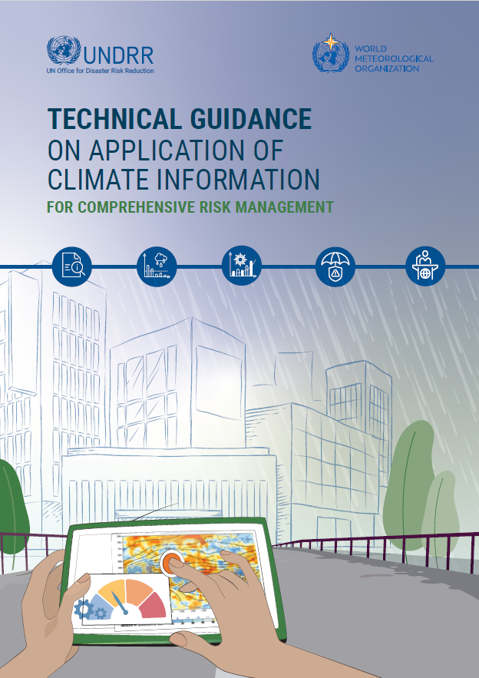
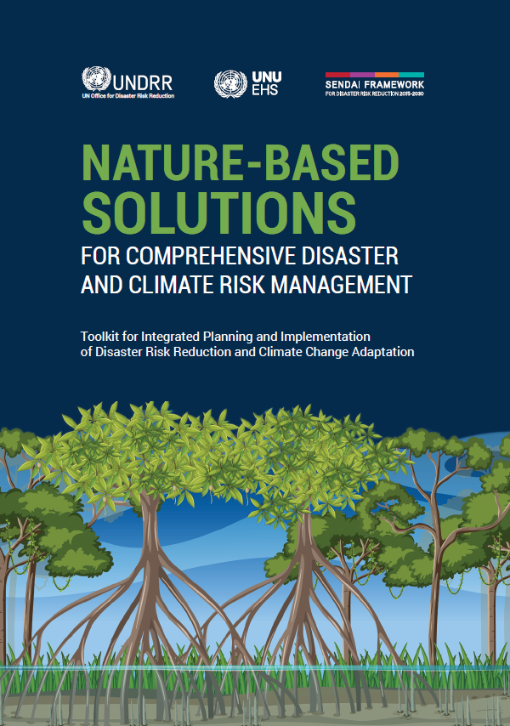
DATA: Assessing biodiversity and ecosystem losses
FRAMEwork for assessing climate and disaster-related Losses of biodiversity and Ecosystem services (FRAME-ECO)

Slide 15
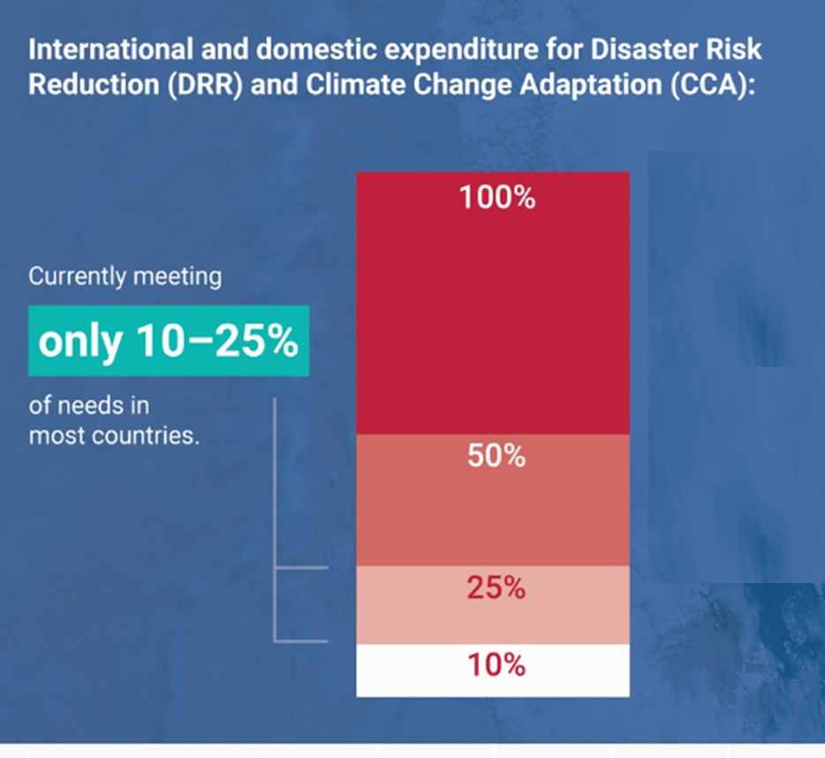
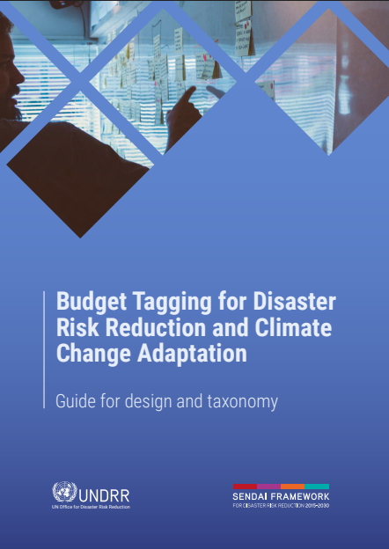
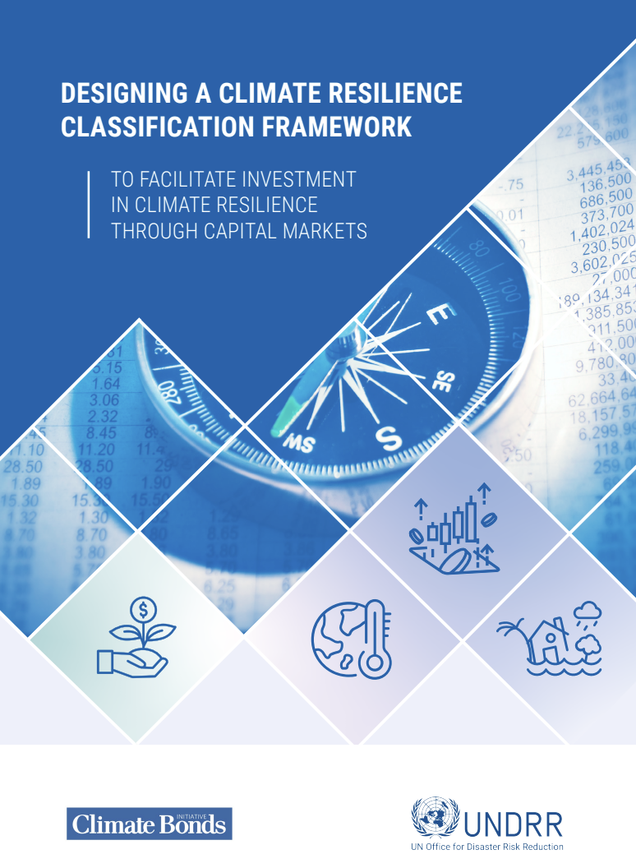
FINANCE: Understanding public finance and budget
DRR RETURNS TO INVESTMENT
Every $1 spent on DRR delivers an average return of $15 in terms of averted future disaster recovery costs
Every $1 invested in more resilient infrastructure in low- and middle-income countries returns $4 in benefit
Despite disaster risk being a driver of fiscal risk
Under-prioritization of DRR in national budgets (often less than 1%)
Domestic resources constrained → More efficient use of existing resources required
Both ring-fencing of budgetary resources for DRR and mainstreaming DRR into sectoral budgets needed
Potential synergies between climate and DRR financing

Slide 16

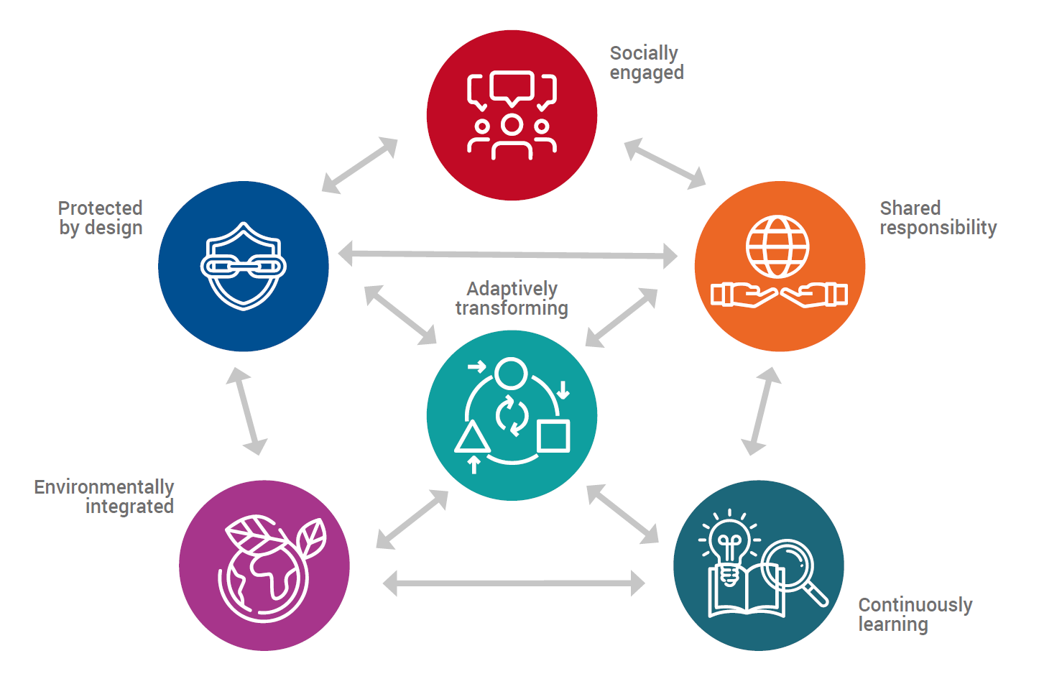
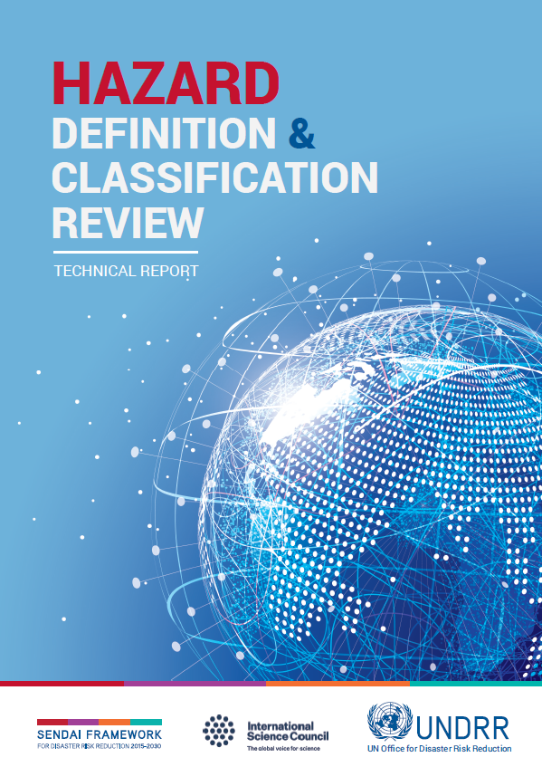
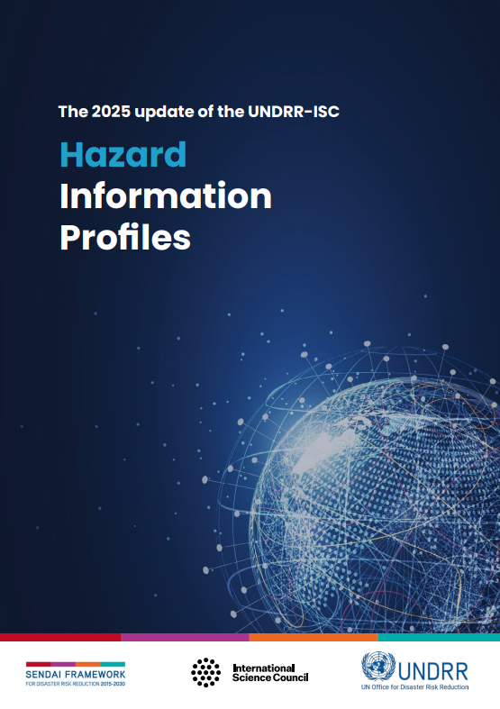
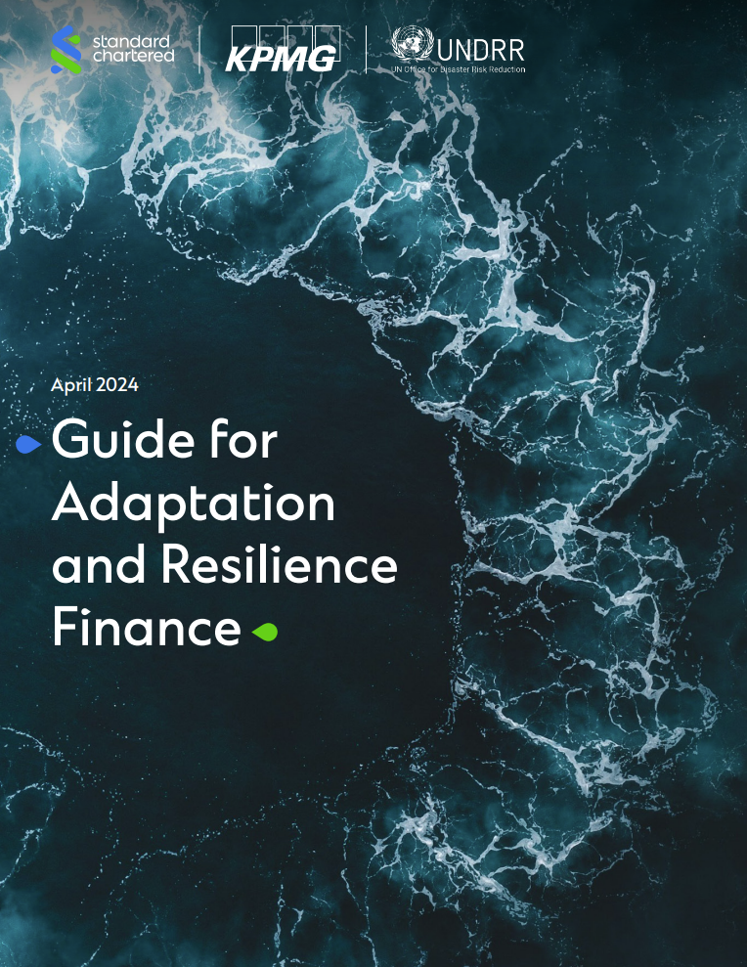
Risk and resilience Standards
Principles for Resilient Infrastructure
Under-development as an international standard – ISO 22372 (draft), published Q4 2025

Slide 17
Leveraging DRR to strengthen national auditing
Stronger accountability in risk governance
Audit stocktake:
  National reporting systems on Sendai Framework, SDGs (and forthcoming GGA indicators)
Audit standards
  Leveraging the most updated DRR data standards and official metrics
Capacity building
  Workshops, and technical guidance and advice
Applying disaster and disaster risk information in the context of auditing
  Access to official statistics and other DRR data
Reporting back to the UN General Assembly (following relevant resolutions) and other intergovernmental mechanisms

Slide 18
Thank you for your attention!
www.undrr.org
Animesh Kumar
Head of Office, Bonn
UN Office for Disaster Risk Reduction
animesh.kumar@un.org
@animesh00

