Slide 1

Webinar housekeeping
Please keep your camera and microphone off during the presentations
For questions:
raise your hand to take the floor
or
type your questions in the chat
Please, introduce yourself and tell us your institution before asking a question or contributing with a comment
*we will share the slides on INTOSAI WGEA website

Slide 2
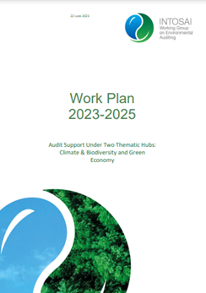
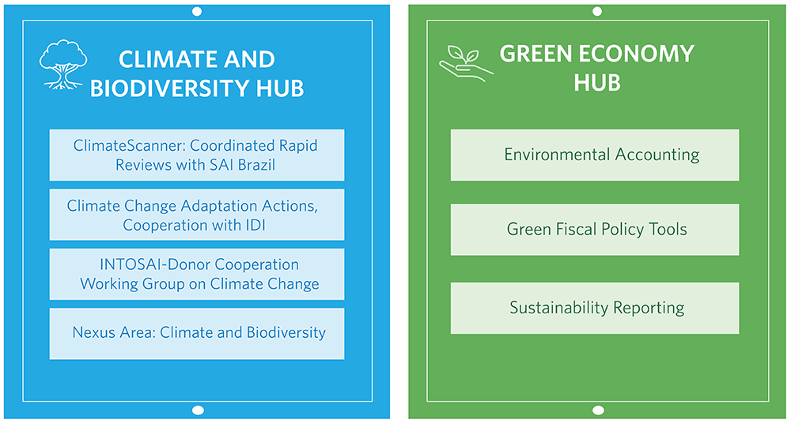
INTOSAI WGEA Project on Green Fiscal Policy Tools

Slide 3
Webinar programme and speakers
Environmental taxes study
Sarah Pearcey (UK’s National Audit Office)
Sarah.Pearcey@nao.org.uk
Lessons learned from auditing major energy and environmental spending
Quindi Franco (U.S. Government Accountability Office)
FrancoQ@gao.gov
Review on energy taxes and subsidies and ongoing audit on plastics own resource
Lucia Rosca and Jose Parente (European Court of Auditors)
lucia.rosca@eca.europa.eu
jose.parente@eca.europa.eu
Overview on environmentally harmful subsidies
Alar Jürgenson (National Audit Office of Estonia)
Alar.Jurgenson@riigikontroll.ee
Questions/Answers/Comments session
joanna.kokot@eca.europa.eu

Slide 4

Environmental tax measures
Sarah Pearcey, Senior Audit Manager
December 2023

Slide 5
What our report covered
HM Treasury (the finance department) and HM Revenue & Customs (the tax department) are responsible for designing and managing tax measures to achieve objectives set by ministers, and for monitoring and evaluating their impact.
In our report Environmental tax measures (nao.org.uk), published in February 2021, we looked at the following areas:
Designing, administering and monitoring environmental taxes: How HM Treasury and HM Revenue & Customs work together to manage the taxes they have defined as environmental taxes.
Do the departments have an overarching approach, that takes account of special factors affecting environmental taxes and promotes good practice?
Do the departments practice effective management in the design, administration and evaluation of environmental taxes?
Managing the relationship between the wider tax system and the government’s environmental goals: How HM Treasury and HM Revenue & Customs manage the wider relationship between the tax system and government’s environmental goals.
What other significant tax measures are there which may have environmental impact, beyond those the departments define as environmental taxes?
How do the departments monitor the environmental impact of these measures?
How do the departments work with the rest of government to understand how the tax system and government’s environmental goals affect each other?

Slide 6
What is an environmental tax?
International definition – used by OECD and EU statistics
An environmental tax is defined as a tax:
  whose base is a physical unit such as a litre of petrol, or a proxy for it, for instance a passenger flight;
  that has a proven specific negative impact on the environment.
In addition to pollution related taxes, all energy and transport taxes are classified as environmental taxes.
UK Government definition
The UK government uses ‘environmental taxes’ to describe taxes with explicit environmental goals. There were four taxes this applied to when we carried out our report
  Climate Change Levy
  Carbon Price Support
  Landfill Tax
  Aggregates Levy
Since our report was published, UK government has introduced another environmental tax – the Plastic Packaging Tax
Other measures we looked at
We also examined other tax measures which met the international definition or would affect the environment.
Other taxes which meet the international definition, such as Fuel Duty and Air Passenger Duty. These taxes are not defined as environmental taxes by the UK government because they were designed to raise revenue. But they are likely to contribute to government’s environmental goals
Tax reliefs with an environmental purpose, such as reducing the tax on low-carbon vehicles or on installing energy-saving products
Tax reliefs introduced for other purposes, but which have an impact on the environment, for example VAT is charged at a lower rate on domestic use of fuel and power

Slide 7
Key findings: Designing, administering and monitoring environmental taxes
An environmental tax can be more complicated to design, and the impact more difficult to evaluate, than other tax measures. This is because it is seeking to change behaviour rather than just raise revenue and because it may overlap with other interventions.
The two departments have not always specified how they will measure the impact of environmental tax measures. Published Tax Information and Impact Notes for changes to environmental taxes often described but did not often quantify the environmental impact. Setting out clear metrics would assist Parliamentary scrutiny.
HM Revenue & Customs does not have a full understanding of the gap between tax due and collected for the environmental taxes.
Landfill Tax has reduced the use of landfill sites significantly, but it has also incentivised more illegal waste disposal. Between 1998 and 2014 HM Treasury increased Landfill Tax by 700%. There was a 65% fall in total waste to landfill by 2014. More waste at authorised landfill sites has been wrongly described to reduce the rate of tax, as well as more waste going to unauthorised sites.
HM Revenue & Customs has limited information on the environmental impact of taxes. HM Revenue & Customs has formally evaluated the impact of one environmental tax (Landfill Tax). HM Revenue & Customs considers this is reasonable given it has limited resources to do evaluation work, there are challenges in evaluating impact, and because it considers that taxing environmentally harmful activity is an efficient way to raise revenue.

Slide 8
Key findings: Managing the relationship between the wider tax system and the government’s environmental goals
There are other taxes which the two departments manage which have an impact on the environment. Neither Fuel Duty nor Air Passenger Duty are managed as environmental taxes. The departments told us that they measure the performance of these taxes in terms of tax revenue raised but they are doing more to consider environmental impact when advising ministers.
HM Revenue & Customs has limited information on the cost and impact of tax reliefs with an environmental impact. HM Revenue & Customs does not have a list of tax reliefs with specific environmental objectives. We conducted our own research and identified 8 reliefs. HM Revenue & Customs has not tried to identify other tax reliefs which could impact on government’s environmental goals. Of the 25 tax reliefs that cost more than £1 billion a year, we identified 5 that are likely to reduce the cost of using fossil fuels (directly or indirectly).
The two departments do not centrally oversee how the tax system impacts on government’s environmental goals. Environmental strategies are developed by other government departments and there are separate routes for announcing tax and spending decisions. The two departments have not worked out the role of the tax system in helping government achieve its environmental objectives.
Achieving government’s environmental goals will require big changes across the economy and the two departments need to consider the impact on the tax system. Environmental policies may impact significantly on existing revenue streams, such as fuel duty. HM Treasury has identified that tax, regulation and spending will all be needed to fund the transition to net zero by 2050. It has started to consider how changes in the structure of the economy will affect tax revenues, but more work will be needed.

Slide 9
Lessons Learned Auditing Major Energy and Environmental Spending
Perspectives from U.S. GAO
IIJA, IRA, & CHIPS
Audits of DOE Loan Programs Office
Audit of Carbon Capture & Storage Demonstrations

Slide 10
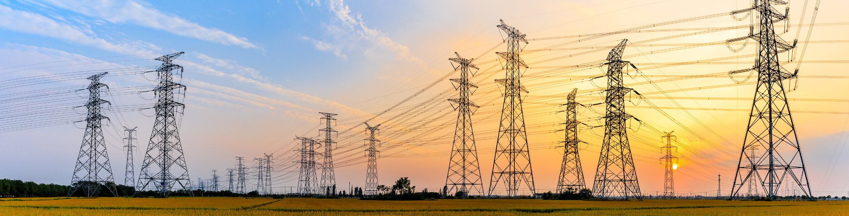
IIJA, IRA, & CHIPS
Recently enacted laws provide billions for energy and environment related purposes:
  Infrastructure Investment and Jobs Act (IIJA)
  Inflation Reduction Act of 2022 (IRA)
  Creating Helpful Incentives to Produce Semiconductors for America Act of 2022 (CHIPS)
New programs & expanded programs
For additional background and GAO audit approach, see: Oversight of Agency Spending: Implementing GAO Recommendations Could Help Address Previously Identified Challenges at Commerce, DOE, and EPA (GAO-23-106726)

Slide 11
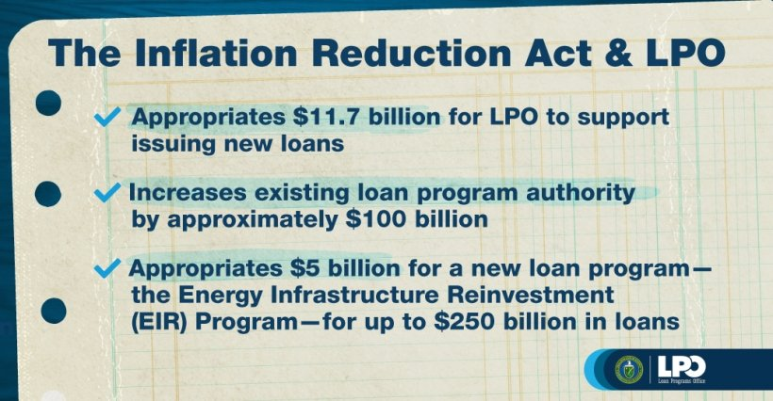
Audits of DOE’s Loan Programs Office
2007: DOE initially focused on expediting program implementation rather than ensuring critical policies, procedures, and mechanisms were in place for success. (GAO-07-339R)
2011-2014: Concerns about DOE not having sufficient expertise, performance measures, or a fully developed loan monitoring function. (GAO-14-367, GAO-12-157, GAO-11-145)
Source: Department of Energy.

Slide 12
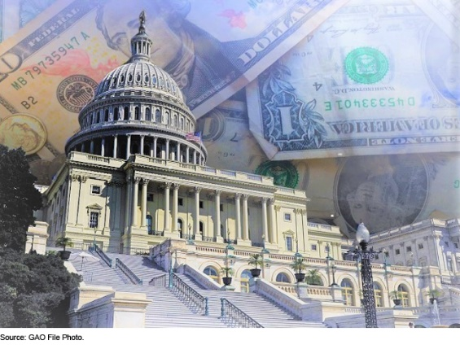
Audit of Carbon Capture and Storage Demonstrations (GAO-22-105111)
We reviewed (1) Outcomes of DOE-funded CCS projects, and (2) DOE management of those projects.
We found:
  Coal projects were generally less successful
  Risks including that DOE supported projects even though they were not meeting required milestones
  A selection and negotiation process that increased risk
We recommended that DOE:
  More consistently administer projects
  Improve selection and negotiation

Slide 13
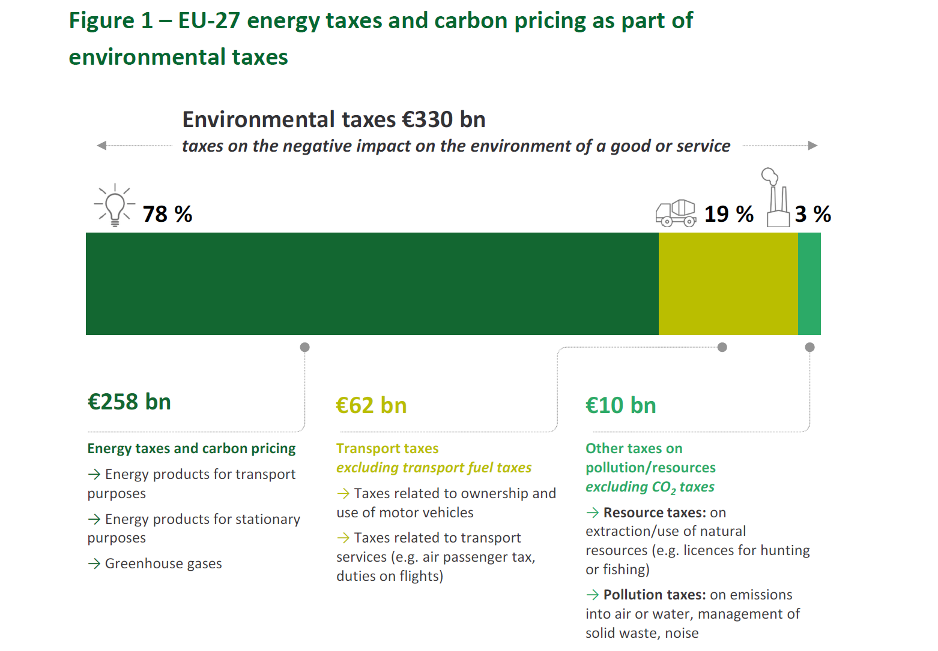
Energy taxation policy as a tool to support climate objectives

Slide 14

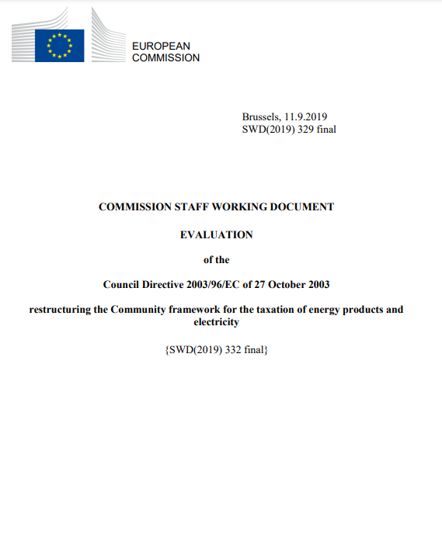
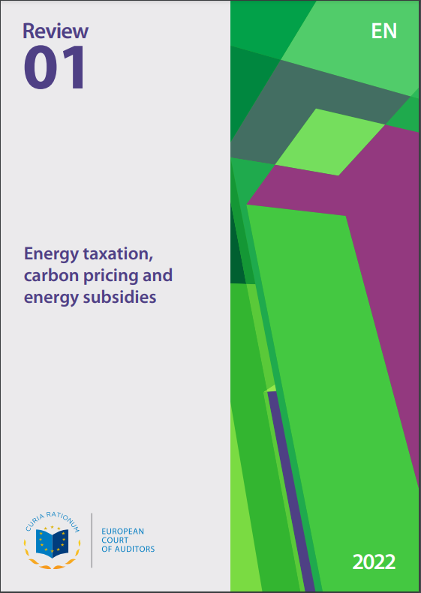
Current Energy taxation Directive (ETD) not fit for purpose anymore
2003 ETD mainly aimed to ensure functioning of internal market
Side objective: Integrate environment protection in energy policy
Commission 2019 evaluation: ETD…
does not support uptake of low-carbon energy
under-prices certain carbon-intensive fuels
provides unclear legal provisions for new fuels
ECA 2022 review:
Minimum levels of taxation do not incentivise use of clean energy
Minimum tax rates are outdated

Slide 15
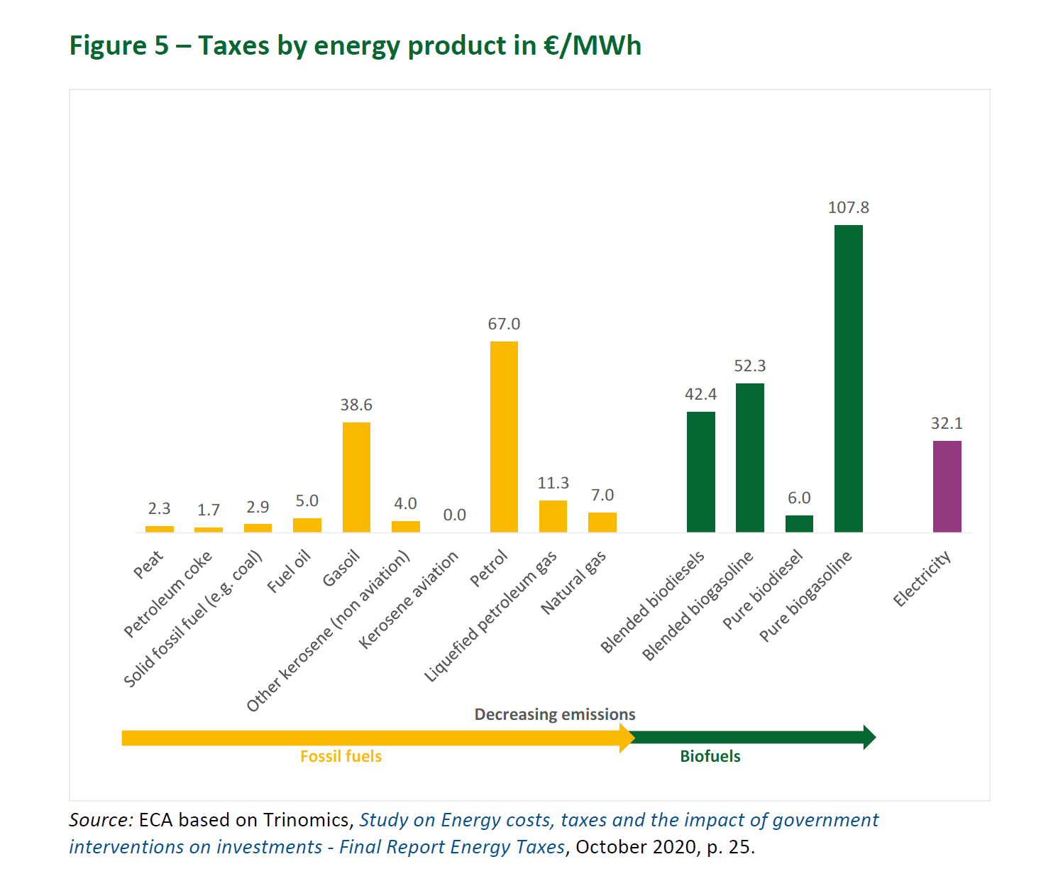

Slide 16





The new ETD proposal addresses some weaknesses
New tax rates based on energy content and environmental and climate performance (no more volume)
Removal of favourable treatment of some sectors (energy intensive businesses, agriculture…) or fuels (diesel, kerosene, heavy oil…)
Scope extended to peat, fuel wood, wood charcoal, alternative fuels (e.g. hydrogen)
Maintain possibility for MS to apply exemptions/reductions for social or environmental reasons
Gradual tax changes over 10 years
Minimum tax rates indexed on inflation

Slide 17
14 December 2023
ECA ongoing audit on the
plastics-based own resource
INTOSAI WGEA webinar on Auditing Green Fiscal Policy Tools

Slide 18
What is the non-recycled plastic package waste-based own resource?
  source of revenue that was introduced in 2021 to finance the EU budget and complementing the existing three own resources: TOR (customs duties) and resources based on member states GNI and VAT;
  follows the Commission’s European Strategy for Plastics in a Circular Economy, where it is indicated that “measures of a fiscal nature could encourage environmentally friendly behaviours”;
  is intended to provide an incentive to reduce the consumption of single-use plastics, foster recycling and boost the circular economy;
  is based on statistical data collected by the Member States and leads to a contribution directly from the Member States budgets.

Slide 19
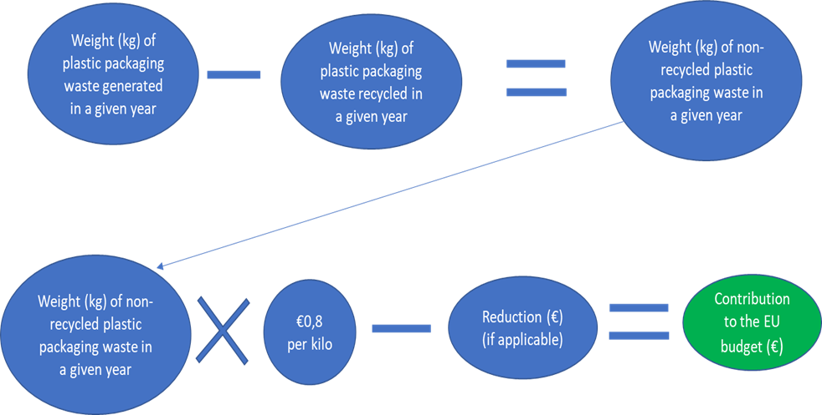
How is the non-recycled plastic package waste contribution calculated?

Slide 20
Did the Commission set up an appropriate framework for managing the own resource based on non-recycled plastic packaging waste?
To answer this question we are checking whether the Commission:
verified that member states apply in a uniform way the relevant aspects of EU legislation related to plastic packaging waste and provide support when necessary;
set up efficient budgetary processes to calculate and collect the member states' contributions;
set up comprehensive procedures to verify the reliability of the statistics submitted by the member states.

Slide 21
The main elements of our approach include:
Desk review of relevant legislation and key Commission documents (procedures, guidance documents, templates, working papers, verification files, correspondence with member states etc.);
Interviews with Eurostat, DG BUDG and DG ENV;
Questionnaire to be sent to the national authorities responsible for data compilation;
Follow up on the information collected through the questionnaire by organising interviews with the authorities concerned (via videoconference);
Information visits to three member states: Romania, Italy and the Netherlands.

Slide 22

Overview of environmentally harmful subsidies
Mr Alar Jürgenson
National Audit Office of Estonia
INTOSAI WGEA webinar on Auditing Green Fiscal Policy Tools
14 December 2023

Slide 23
What are environmentally harmful subsidies?
Types of subsidies:
Direct spending (transfers of funds from state budget)
Energy
Grants and subsidies to fossil fuels
Energy tax reductions for certain sectors (e.g manufacturing, agriculture)
Tax expenditures (exemptions, deductions, credits)
Transport
Support to airports, roads;
User fees
Credits
Agriculture
Aid for competitiveness of agriculture (i.e EU CAP subsidies)
Reduced VAT rate for agricultural inputs (e.g fertilisers and pesticides);
Induced transfers (purchase mandates, market price support, tariffs)
Other – Water
Below-market pricing or free allocation of water use rights to agriculture and industry
Regulations, externalities
Report: Financing Our Survival: Building a Nature Positive Economy through Subsidy Reform (2022) https://www.businessfornature.org/news/subsidy-reform

Slide 24
Action plan of phasing out environmentally harmful subsidies
Activities
• Defining an environmentally harmful subsidy, determining its scope and fields of activity (sectors)
• Assessing the availability of data for a more accurate assessment
List of potential environmentally harmful subsidies
• A more detailed assessment of the environmental and socio-economic impacts, effectiveness and efficiency of the subsidy
• Consideration of alternatives
• Selection of suitable subsidies for reforming
• Proposing a transitional period, compensation mechanisms
Identification of subsidies with significant negative environmental impact, assessment of their impact and rationality.
Selection of suitable subsidies for modifying
• Finding opportunities for change and reform
• Inclusion of stakeholders, informing them
• Ex-post evaluation of changes
Phasing out of subsidies with significant negative impacts on the environment
Identification
Assessment
Phasing out
Result

Slide 25
About the report
Why overview?
New concept - never been discussed before by politicians or in society;
No agreed definition of EHS in Estonia, the EU or the world;
Very little data on EHS in Estonia. Identification of potential subsidies -> by analogy with other countries;
Our goal - to support and encourage the parties, not criticize;
Challenges
Perception of the concept of EHS
Topic is divided between different government agencies -> no clear leader. Determined coordination required
Strong opposition from ministries and affected stakeholders -> communication

Slide 26
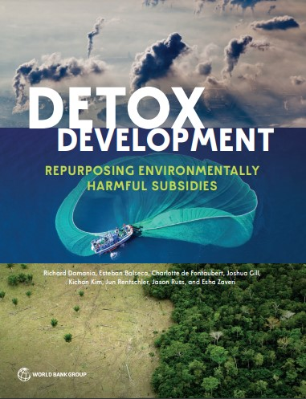
Environmentally harmful subsidies in the world
Subsidies for fossil fuels, agriculture and fisheries –
over 7 trillion USD, i.e 8% global GDP*
Direct expenditures – 1,25 trillion
Indirect subsidies – over 6 trillion
Inefficient subsidies are making climate change worse. I.e. loss of forest, premature deaths
Countries spend 6 times more on subsidizing fossil fuel than commitments to tackle climate change.
“People say that there isn’t money for climate but there is – it’s just in the wrong places.”
*World Bank report: Detox Development (2023): https://www.worldbank.org/en/topic/climatechange/publication/detox-development
Notes:
Government subsidies of $577 billion in 2021 to artificially lower the price of polluting fuels, such as oil, gas, and coal, exacerbate climate change, and cause toxic air pollution, inequality, inefficiency, and mounting debt burdens.
Agriculture subsidies are responsible for the loss of 2.2 million hectares of forest per year - or 14% of global deforestation.
Fossil fuel usage—incentivized by subsidies—is a key driver of the 7 million premature deaths each year due to air pollution.
Fisheries subsidies, which exceed $35 billion each year, are a key driver of dwindling fish stocks, oversized fishing fleets, and falling profitability

Slide 27
Takeaways
Environmentally harmful subsidies waste public money and restrict achieving environmental objectives, i.e tackle climate change and support adaptation.
Harmful subsidies are widespread and their monetary value is significant.
No excuse to delay identification and quantification of potentially environmentally harmful subsidies. There are internationally accepted methodologies (OECD, IEEP) waiting to be utilized.
Identification and assessment of harmful subsidies provides opportunities for SAI-s to carry out their tasks:
overview of inefficient and harmful subsidies -> way to save public funds
design effective measures (incl. social, economical targets) -> improve policy making
ensure achieving environmental objectives (water, biodiversity, climate change and etc.)
Auditors: Ms Viire Viss and Mr Alar Jürgenson
Link to NAOE report (in English): https://www.riigikontroll.ee/tabid/206/Audit/2544/language/et-EE/Default.aspx

