Slide 1

^{Presentation to}
^{INTOSAI WGEA}
^{Simon Upton | 1 July 2025}
Kea, mountain parrot

Slide 2


Ngātoroirangi Mine Bay Māori Rock Carvings
Governor General (representative of the Sovereign)
Parliament
Executive
House of representatives
Ministers
Advise
Monitor
Government agencies
Local government
Monitor
Officers of Parliament
Parliamentary Commissioner for the Environment
Controller & Auditor General
Ombudsman

Slide 3

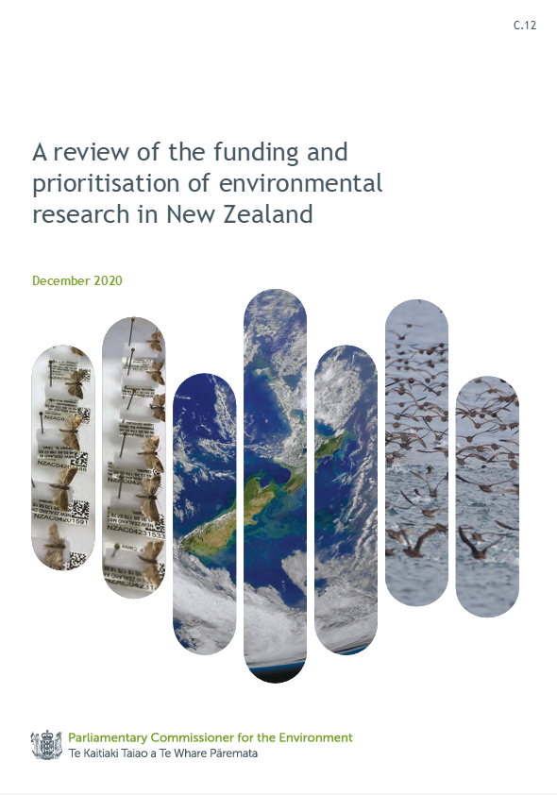
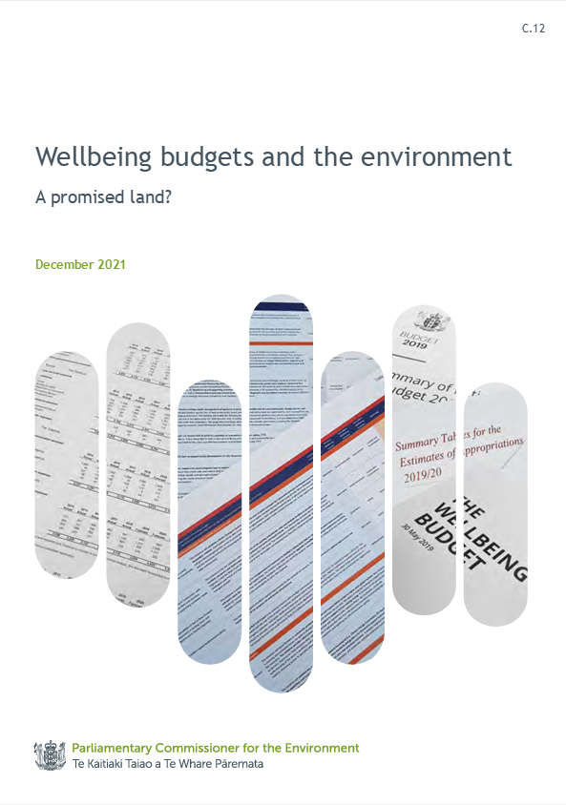
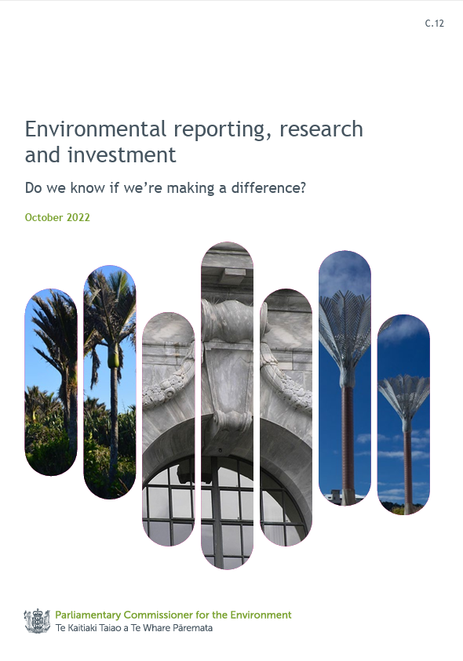
INTOSAI Working Group on Environmental Auditing Conference

Slide 4

What accountability and performance should tell us
the reasonableness of the Government's choice of environmental outcomes
whether expenditure is at the right level to achieve outcomes
whether whatever is being spent is being spent effectively
INTOSAI Working Group on Environmental Auditing Conference

Slide 5





INTOSAI Working Group on Environmental Auditing Conference
Long-term enduring outcomes
Defined, preferably in legislation
(e.g. 2050 emissions reduction target)
Government priorities and objectives
Plans and strategies
How money is spent
Each elected Government
Each government defines the polices and actions it will implement to meet its objectives.
Expenditure is reported by outcome across agencies (as well as appropriation).
Each government publicly states its priorities and objectives to contribute to the enduring outcomes.
Accountability
Impact of spending
Progress towards enduring outcomes and government objectives is tracked using real world data (including assessment of time lags and uncertainty).
Whole-of-government reporting
Governments report to Parliament on progress towards each enduring outcome and policy and expenditure needed to make further progress.

Slide 6
INTOSAI Working Group on Environmental Auditing Conference
Long-term enduring outcomes
Not often defined
Government priorities and objectives
Plans and strategies
How money is spent
Each elected Government
Lack of clarity about what plans and strategies will be implemented to deliver objectives and how they will interact.
Information on government spending is provided publicly at the appropriation level, which is coarse and siloed by agency.
Lack of clarity about what environmental outcomes have been given priority.
Accountability
Impact of spending
Performance measures often do not measure or relate to real world changes
Whole-of-government reporting
No way to link outcomes back through the chain of expenditures – strategies – priorities or to look across agencies.

Slide 7

INTOSAI Working Group on Environmental Auditing Conference
“
The challenges the report identifies exist across nearly all areas of public spending. I am concerned that it is often not clear to the public or Parliament what outcomes are being sought by governments, how that translates into spending, and ultimately what is being achieved with the public money the Government spends – about $150 billion last year.
“
Auditor-General John Ryan

Slide 8

Piwakawaka, fantail
Recommendations
The Government should clearly state its environmental outcomes and how it will achieve them.
Agencies should tag expenditure that relates to the Government's outcomes and report on their contribution.
The Government should provide a whole-of-government report to the House on the expenditure it allocates to environmental outcomes and the progress that is being made.
INTOSAI Working Group on Environmental Auditing Conference

Slide 9

Enduring outcomes
Improving biodiversity and ecosystem functioning and resilience
Reducing pollution and waste
Reducing greenhouse gas emissions and adapting to climate change
Improving the coastal and marine environment, including sustainable management of resources
Improving the efficiency and effectiveness of institutions designed to manage human interventions in the environment
Improving land and freshwater, including sustainable management of resources
INTOSAI Working Group on Environmental Auditing Conference

Slide 10
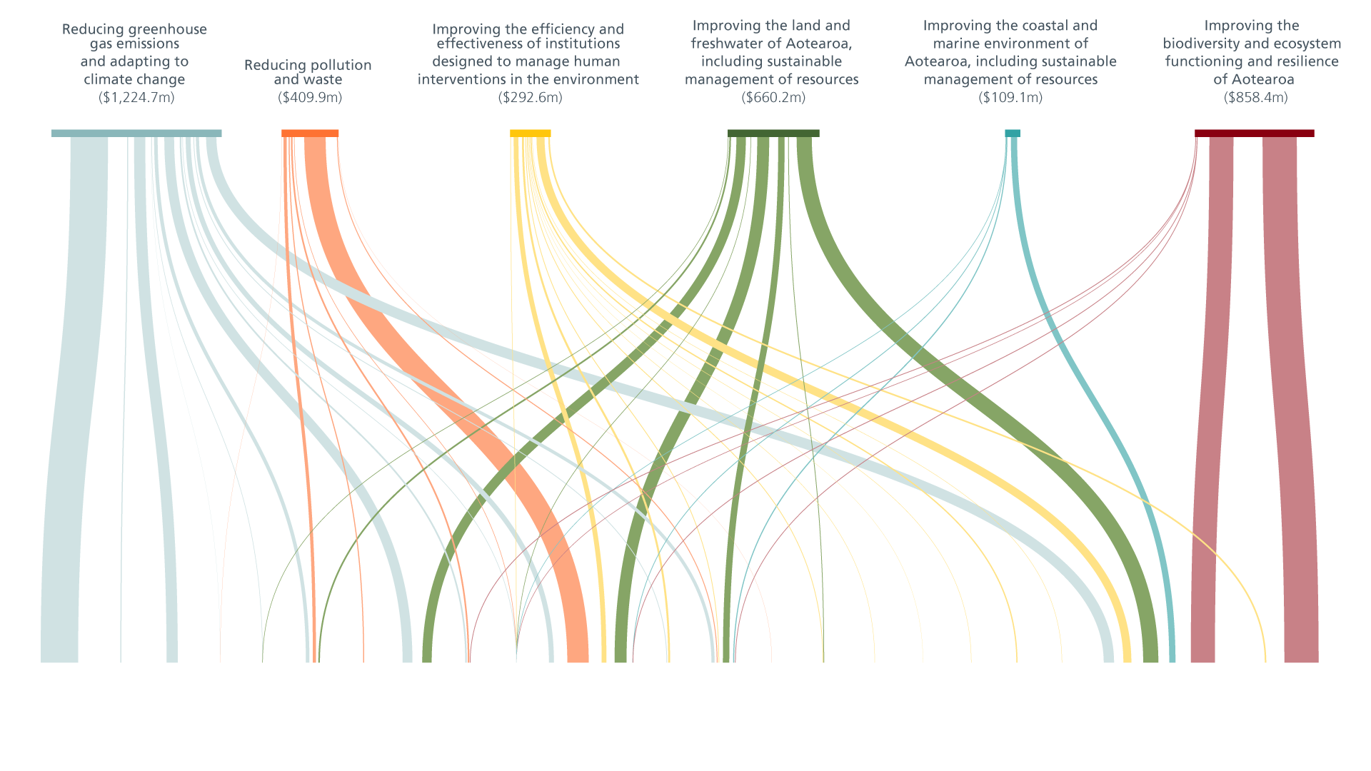
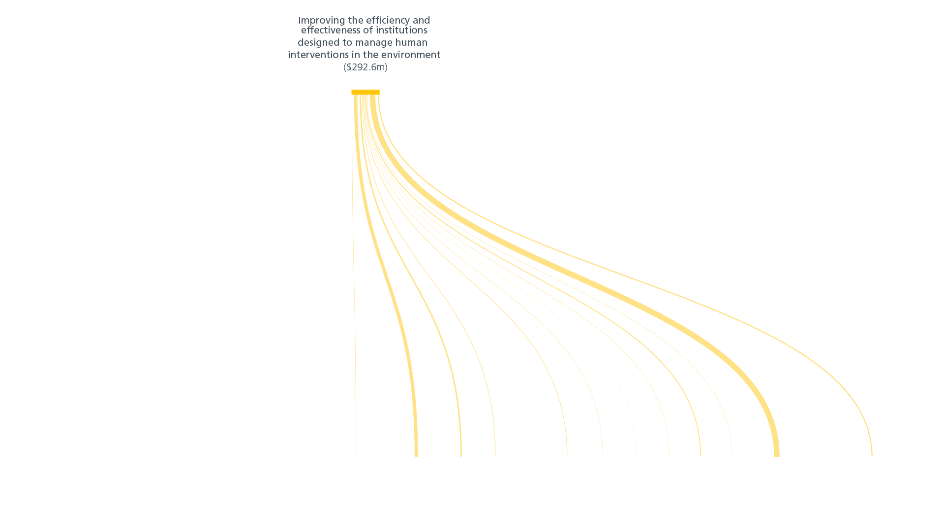


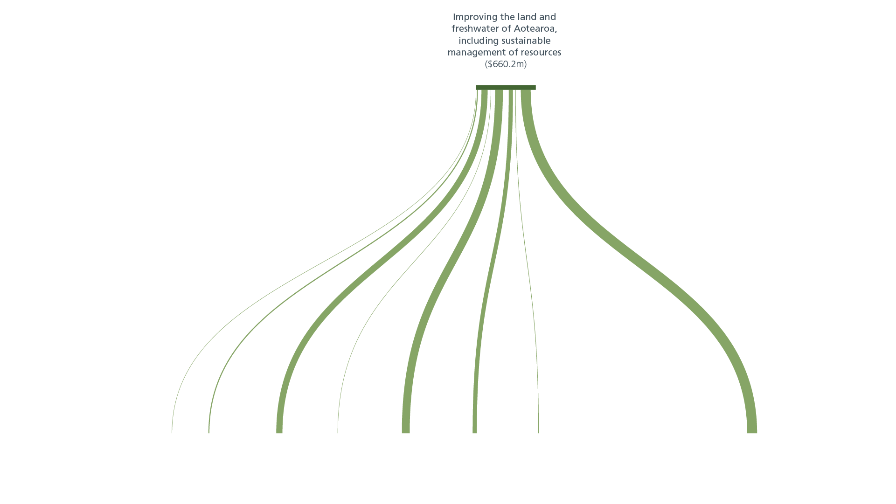


INTOSAI Working Group on Environmental Auditing Conference

Slide 11
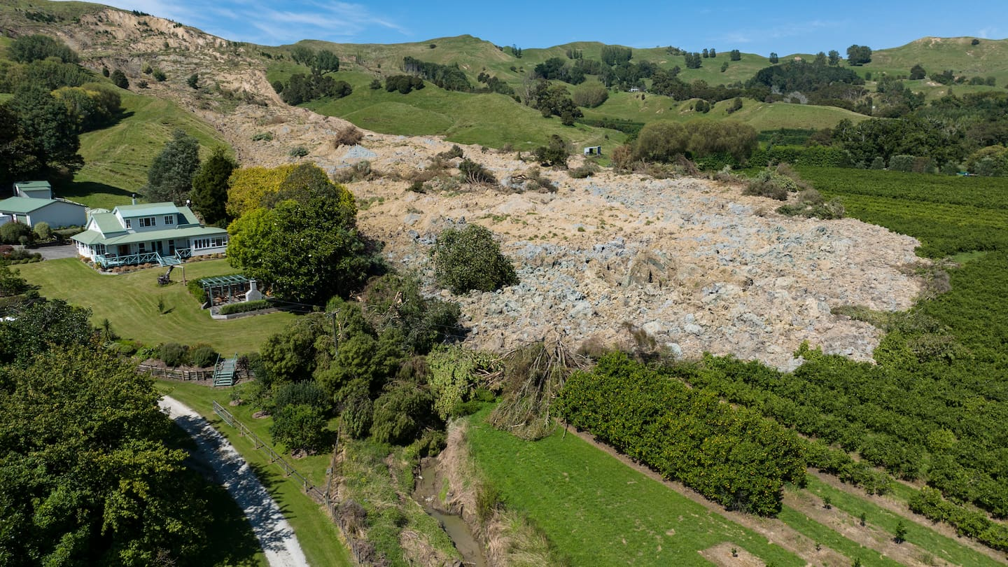
Tairāwhiti, New Zealand. George Heard, NZ Herald
INTOSAI Working Group on Environmental Auditing Conference

Slide 12

EEE issues
subjective application of framework
inconsistency between datasets
deficiencies in environmental information
INTOSAI Working Group on Environmental Auditing Conference

Slide 13

INTOSAI Working Group on Environmental Auditing Conference
Long-term enduring outcomes
Not often defined
Each elected Government
Government priorities and objectives
Plans and strategies
How money is spent
Lack of clarity about what plans and strategies will be implemented to deliver objectives and how they will interact.
Information on government spending is provided publicly at the appropriation level, which is coarse and siloed by agency.
Lack of clarity about what environmental outcomes have been given priority.
Accountability
Impact of spending
Performance measures often do not measure or relate to real world changes
Whole-of-government reporting
No way to link outcomes back through the chain of expenditures – strategies – priorities or to look across agencies.

Slide 14
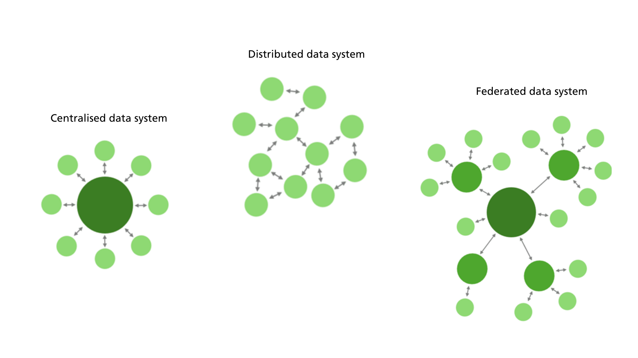
INTOSAI Working Group on Environmental Auditing Conference

Slide 15

^{Thank you.}
Koru, fern frond

