Slide 1



Are mechanisms in place to ascertain the designation and effective management of MPAs within the Mediterranean Sea?
Akis Kikas
SAI Cyprus
Joint Cooperative Audit
July 2019
William Peplow
SAI Malta

Slide 2
Contents
Why we did this audit
Participating SAIs
Main Audit Question
Methodology
The legislative framework
Risk Assessment
Strategies
The Management of MPAs
Monitoring
Conclusions
Lessons learnt

Slide 3
Why we did this audit
Mediterranean SAIs acknowledged the various problems relating to the sustainability of the marine environment
Subject of concern for all Mediterranean SAIs
Importance of the Mediterranean as a habitat for endangered/critically endangered species
Importance for the recreation of civilians and for the economy as a significant tourism product
High risks and threats stemming from urbanisation, tourism, shipping traffic, overfishing, pollution, climate change
Relatively limited scope of the audit, therefore easier to manage

Slide 4
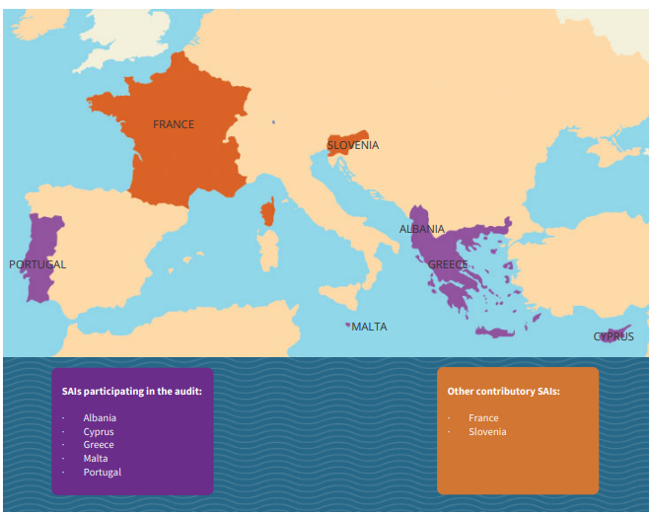
Participating SAIs

Slide 5
Milestones
Conclusion of National audits by mid 2018
Albania, Cyprus, France, Greece, Malta, Portugal, and Slovenia concluded national audits
Consolidation of joint report
National report findings shared between cooperative audit partners
Publication of joint report by July 2019
Dissemination of joint report in main environmental meetings

Slide 6
Main audit questions
Are MPAs appropriately safeguarded across Mediterranean countries?
Is the legislative framework comprehensive?
Are national strategies robust?
Were MPAs designated following the carrying out of adequate assessments?
Were management plans drafted?
Are MPAs being effectively managed?
Are responsible entities monitoring MPAs?

Slide 7
Methodology
Documentation review
Interviews with stakeholders
Observation in national conferences
Benchmarking
Site-visits

Slide 8
The Legislative Framework
The legislative framework comprises National Legislation, EU Directive and United Nations Conventions
In many instances the legislative framework appropriately mandates countries to establish and manage MPAs
Some MPAs were designated through various legislation resulting in multi-protection status
Limited coordination exists in situations where multiple legislative responsibilities are assigned

Slide 9
Risk Assessments
Countries have completed various studies to assess the feasibility of designating MPAs
Limitations of assessments undertaken:
Assessments did not extend to cover all waters within jurisdiction
Assessments were of limited technical scope as certain types of threats and pressures were not specifically assessed

Slide 10

Strategies
Most of the participating SAIs noted that their respective countries have a national strategy
However, the following issues were noted:
  In one case, the national strategy covers biodiversity but is not MPA specific
  Some SAIs reported that national strategies are fragmented
  National strategies lack specificity, time frames and measurable targets
  In cases, resources have not been allocated to enable the full and timely implementation of strategies

Slide 11
The Management of MPAs was hindered due to Management Plans related weaknesses
The management of MPAs was mainly dependent on Programme of Measures and Management Plans
MPAs were still not supported by Management Plans
In cases, there was an absence of:
Measurable targets
Identified responsibilities
Plan reviews and updating
The appropriate level of resources had not been allocated to enable the implementation of management plans
The implementation of management plans was subject to coordination limitations

Slide 12
Monitoring
Monitoring of MPAs by national authorities is generally incidental and reactive
    There is no established programme based on risk assessments to monitor MPAs
    Coordination between the stakeholders involved in the monitoring of MPAs is weak

Slide 13

Conclusion: The better safeguarding of MPA is dependent on countries addressing these critical areas of concern
Comprehensive legal framework but some minor inconsistencies prevail
Strategic framework not supported by appropriate resources and, in cases, action plans
Assessments follow generally accepted practices but limitations in scope prevail
Prolonging of management plans raises the risk of marine environment degradation and possibly missing EU obligatory targets
Monitoring and enforcement remains incidental and reactive as well as based on existing legislation rather than site specific management plans

Slide 14
Lessons learned
(1 of 2)
Understanding the complexities of competing interests
Diverse national priorities
Immediate economic interests vs sustainable blue growth
Managing the fragmentation of responsibilities
Problems of coordination
Rationalisation of different organisational goals
Not always a question of one size fits all
Different circumstances prevail for specific MPAs
Need to develop site specific audit criteria

Slide 15


Lessons learned
(2 of 2)
  Managing expert advice
  We needed to broaden our knowledge on MPAs
  We needed to priorities areas where we sought expert advice
  Attending conferences and seminars organised by stakeholders
  Exploiting knowledge sharing opportunities with other SAIs participating in the cooperative audit
  Understanding the tensions brought about by the international political scene
  Conflicts within the Mediterranean
  Priorities shift from environmental sustainability
  Understanding the political sensitivities concerning jurisdiction

Slide 16
NAO Malta Follow-Up Audit in 2021
3 strategic recommendations were fully implemented
2 administrative recommendations were partly implemented
3 operational recommendation out of which:
1 was fully implemented
1 was partly implemented

Slide 17
Strategic recommendations
Establishment of MPAs with neighbouring countries towards better conservation of the marine environment | Progress but not fully addressed due to geopolitical climate issues.
Finalisation of a national strategy on environmental policy (NSE) | The draft NSE covering up to 2050 was issued for public consultation in 2022.
Addressing the potential conflict of interest due to ERA’s role as environmental regulator and implementer of measures | Partly addressed through the distinct roles of the Environment and Resources (policy) and the Compliance and Enforcement Directorates (regulatory) as well as the setting up of the than Ambjent Malta

Slide 18
Administrative Capacity Recommendations
Responsible maritime sector entities were missing administrative capacity – Initiated a recruitment process were both ERA and Ambjent Malta increased their staff complement
The compilation of surveillance compliance monitoring and enforcement plans embracing risk analysis principles – plans in relation to marine monitoring and related programme of measures were adopted and implemented through domestic funding and EU and UN projects.

Slide 19
Operational Recommendations
ERA needed to invoke the legislative provisions related to Conservation Orders - draft Conservation Objectives and Measures were published for public consultation in July 2021. Documents and a public campaign on MPAs followed.
Cooperation and coordination between national authorities required strengthening through MOUs – MOUs were signed with DFA, TM, CSD regarding the use and exchange of data.
The compliance and enforcement functions required technological support – considerable budget was spent on equipment. A number of systems were being developed for the use of the national authorities involved. Multiple information-sharing systems were designed and made publicly available.

Slide 20



SAI Cyprus audit – what happened since?
Formal follow up audit not yet carried out however a quick review has indicated that, although some actions have been taken, there are still important issues that are pending.
The network of MPAs has been expanded and it is considered that now the appropriate coverage of representation of species and habitats of Community interest in the Natura 2000 network has been achieved.
Monitoring activities have been strengthened through the procurement of services from the private sector
Conservation targets and legally binding management measures, through the issuance of Ministerial Decrees are still pending for all MPAs

Slide 21

Thank You

