Slide 1

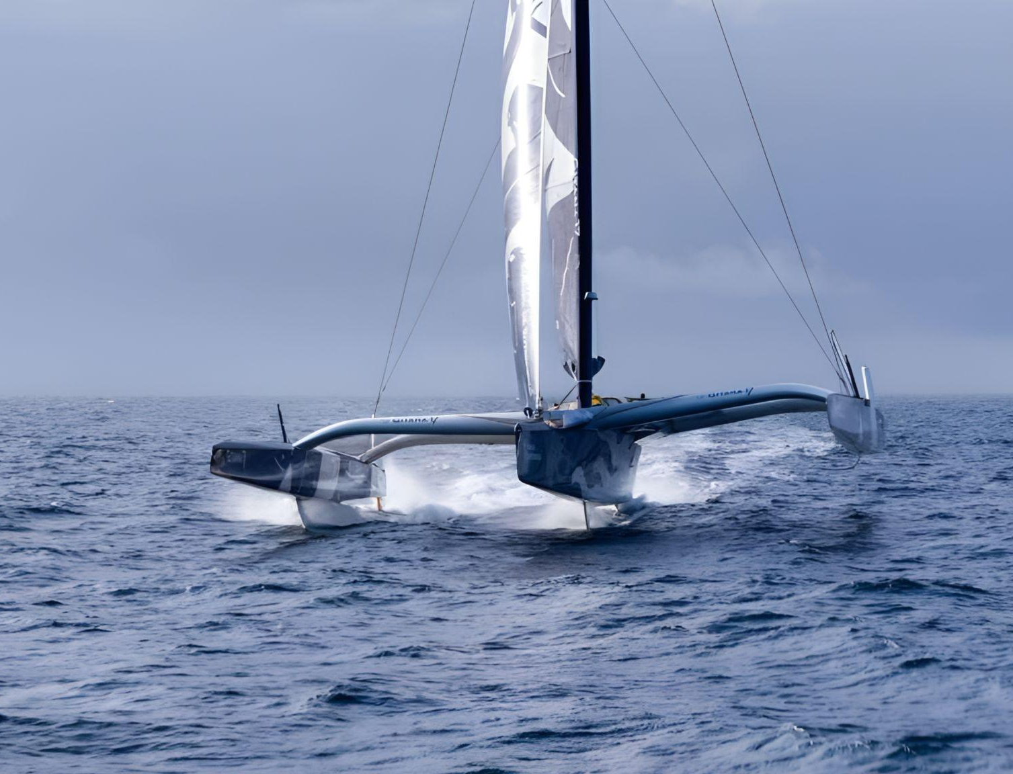

What is the current state of the Mediterranean's health in light of the findings of the Barcelona Convention?
Dr. Sc. Robin DEGRON
Director of Plan Bleu (UNEP/MAP)
INTOSAI WGEA,
Malta, 1-2 July 2025

Slide 2

Plan Bleu and its Observatory
A French NGO and a Regional Activity Centre of UNEP/MAP and Barcelona Convention system, dedicated to environmental analysis and sustainable development in the Mediterranean. A key monitoring and assessment body for the region.
Pillars and Thematic Areas of Plan Bleu
Monitoring / Foresight / Socio-economic Analyses / Sustainable Finance / Science-Policy Interface / Climate change Adaptation / Water / Biodiversity / Forests / Cities / Tourism
Mediterranean Strategy for Sustainable Development & Indicators
Monitoring and Revision of the Mediterranean Strategy for Sustainable Development
Monitoring of sustainable development indicators, assessment of countries' progress, and support for guiding public policies.
Regional Cooperation
00%
Knowledge sharing and strategic recommendations to support Mediterranean countries in transitioning towards more sustainable and coherent public policies.

Slide 3

The core indicators of the Mediterranean Strategy for Sustainable Development:
01
Demographics
04
Real GDP per capita
07
Water availability per capita
Territorial carbon dioxide emissions per capita
02
Life expectancy at birth
05
08
Marine plastic emissions
Average years of schooling
Surface air temperatures (SAT)
09
Air quality
03
06
10
Evolution of protected marine areas

Slide 4
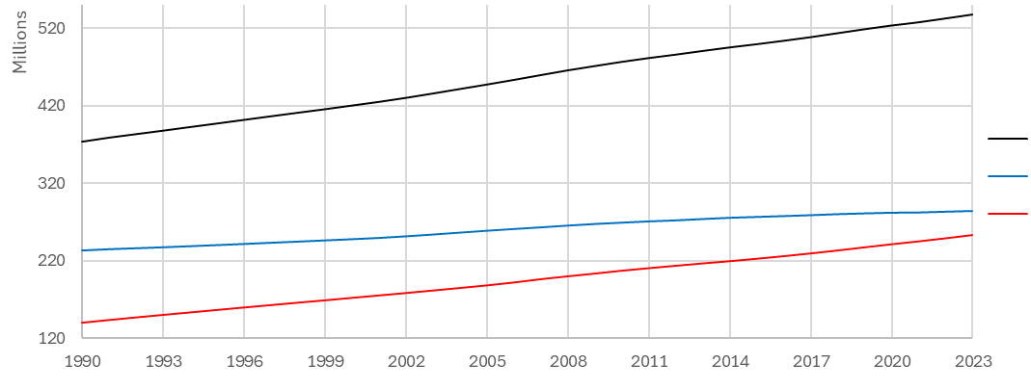
Indicator 1 : Demographics
Population of the Mediterranean (sum of the annual populations of Mediterranean countries)
Evolution of Mediterranean populations compared by coastlines, from 1990 to 2023.
Populations (number of inhabitants)
Mediterranean
Northern shore
Southern shore
Between 1990 and 2023, the Mediterranean population increased by 163 million people (+43.8%).
The growth rate of the Southern shore is higher than that of the Northern shore (+81.1% versus +21.5%).
The Northern shore is "aging" (25% of its population is over 60, compared to 11% in the South), while the Southern shore is "younger" (37% of its population is under 20, compared to 21% in the North).
Source: UNDP - 2023

Slide 5

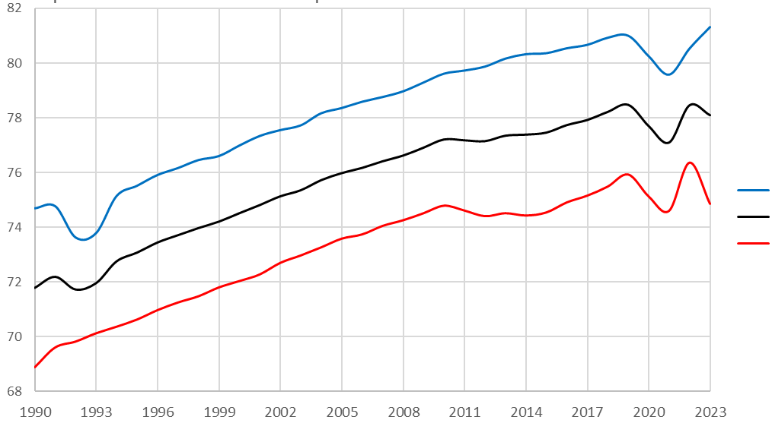
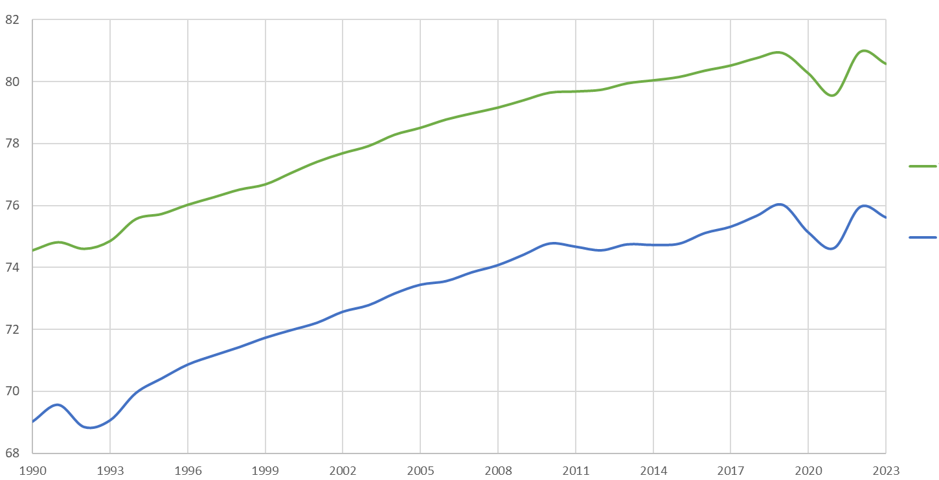
Indicator 2 : Life expectancy at birth
Average number of years a person is expected to live at birth
Life expectancy at birth by Mediterranean shorelines from 1990 to 2023.
Years
Northern shore
Mediterranean
Southern shore
Life expectancy at birth (for men and women) in the Mediterranean, from 1990 to 2023.
Years
Between 1990 and 2023, a clear increase in life
Mediterranean
woman
expectancy across the Mediterranean was observed.
Mediterranean
man
(slight decline since 2021).
Significant disparities between the shores of the basin
(80 years in the North versus 75 years in the South)
as well as between genders.
Source: UN program and report - 2021

Slide 6
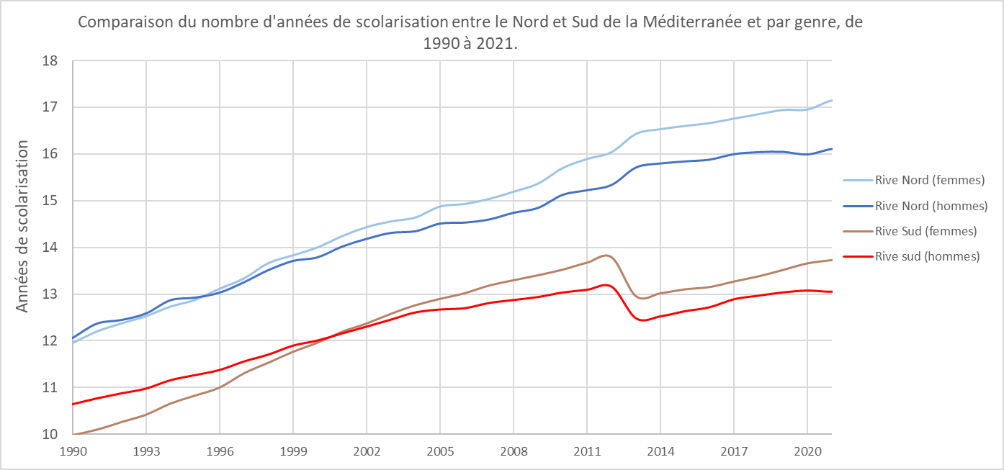
Indicator 3 : Average years of schooling
Average number of years of schooling received by individuals aged 25 and over.
4o
Comparison of average years of schooling between the Northern and Southern Mediterranean, and by gender, from 1990 to 2021
Years of schooling
Northern shore (women)
Northern shore (man)
Southern shore (women)
Southern shore (man)
Between 1990 and 2021, there was a clear increase in average years of schooling (around +4 years), consistently above the global average (10 years compared to 8).
Significant disparities remain between Northern (11 years) and Southern (9 years) Mediterranean regions, as well as between genders.
Across the Mediterranean, only 21% of women with degrees hold skilled employment.
In both the North and the South, women tend to pursue more years of education than men.
Source: UN program and report, 2021

Slide 7
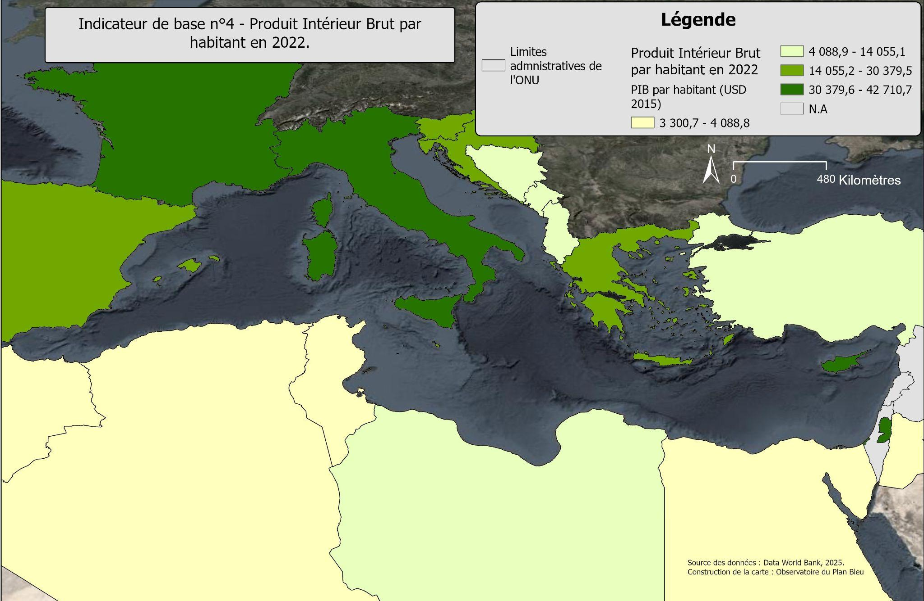
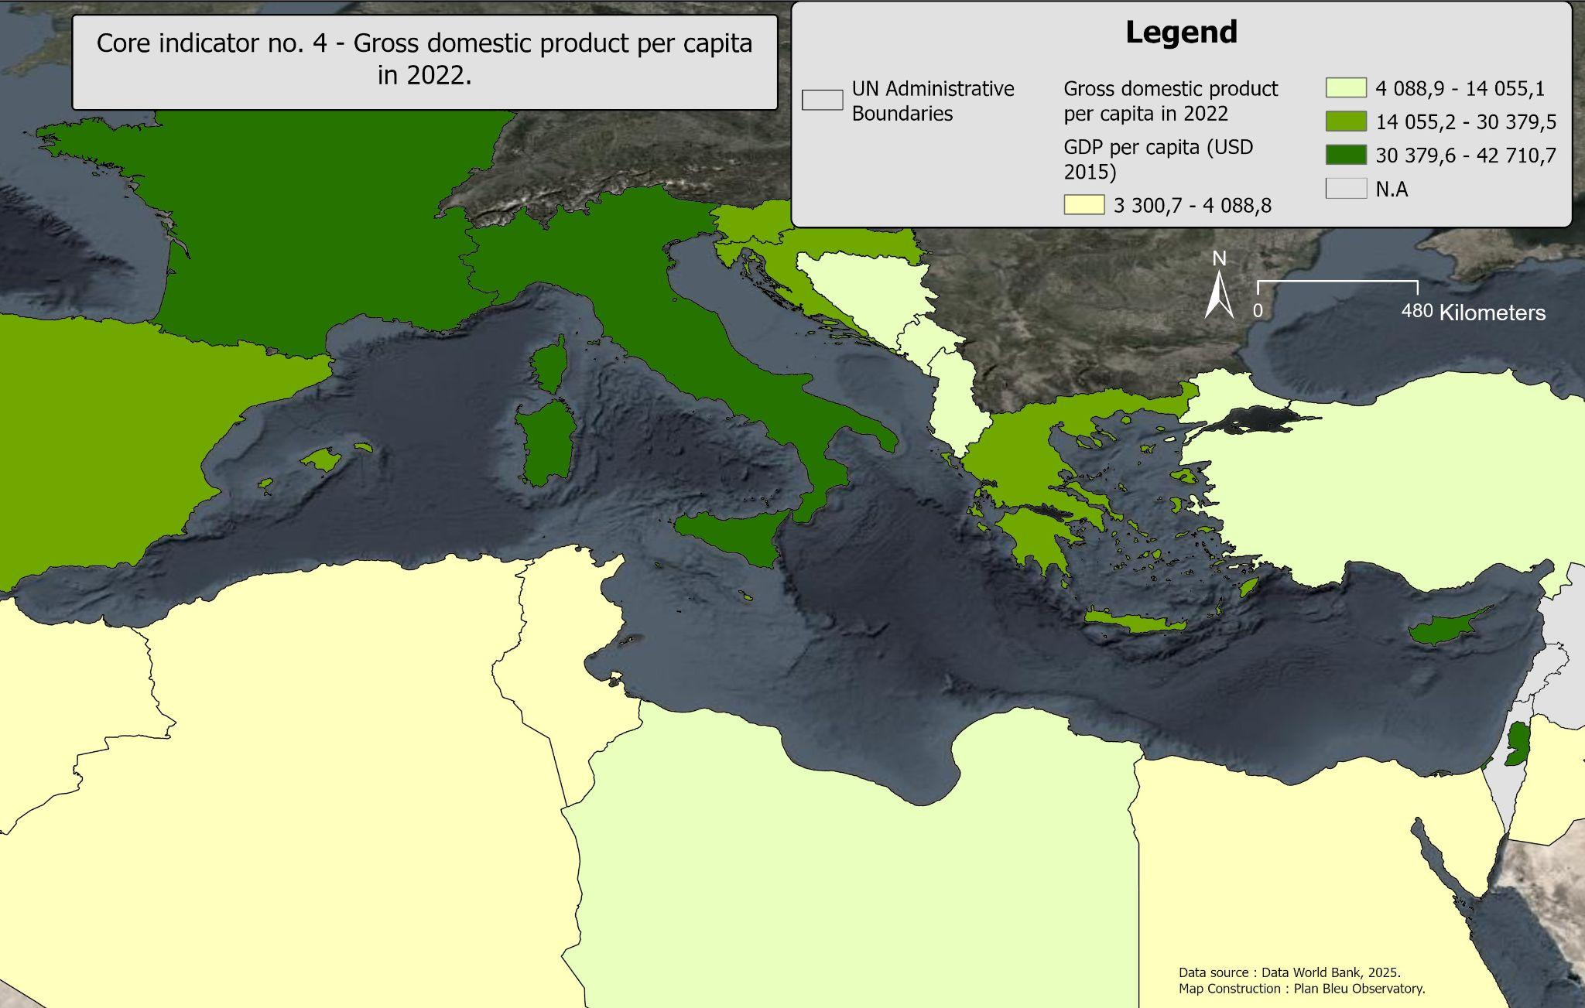
Indicator 4 : Gross Domestic product per capita
Marked national economic disparities. Since the 2000s, Northern Mediterranean countries have shown higher levels of GDP per capita and stronger GDP growth rates than those in the South.
Since the early 2000s, GDP per capita in the Mediterranean has increased significantly (with a more pronounced rise in the North than in the South)
Source: OECD, 2022.

Slide 8
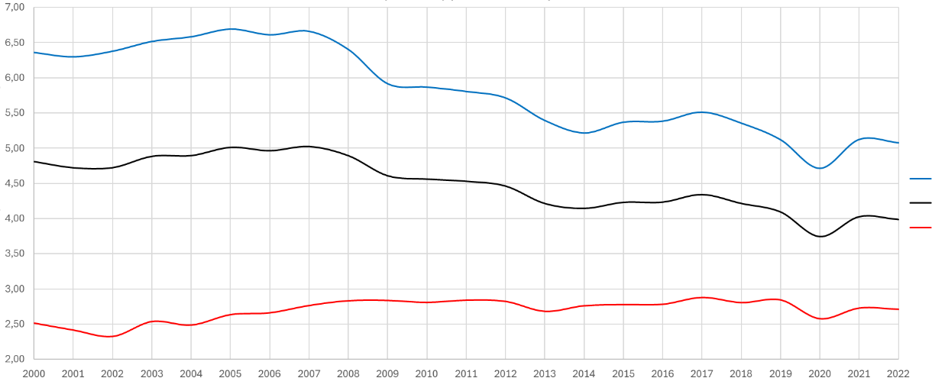
Indicator 5 : Territorial carbon dioxide emissions per capita
Resident CO2 emissions in the country, divided by the total population.
Evolution of CO2 emissions (tons) per capita by Mediterranean shore from 2000 to 2022.
Emissions (tons per capita per year)
Northern shore
Mediterranean
Southern shore
Since 2000, a decrease in CO2 emissions per capita has been observed. This reduction is more pronounced in the North (6.45 tons per capita in 2000 compared to 5.1 tons per capita in 2022).
Conversely, there has been a slight increase in CO2 emissions per capita in the South (2.50 tons per capita in 2000 compared to 2.7 tons in 2022).
Source: UNDP - 2021.

Slide 9
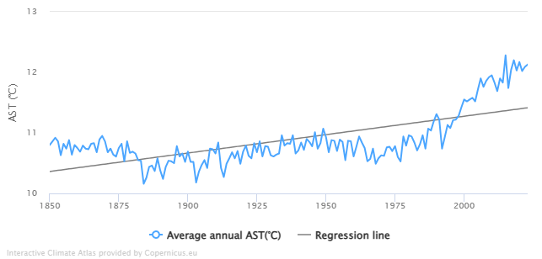
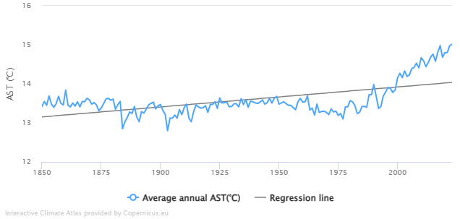
Indicator 6 : Surface air temperatures (SAT) (1/2)
The SAT is defined as the air temperature (in °C) at 2 meters above the ground surface.
Average annual variations in surface air temperature from 1850 to 2023 in France.
Average annual variations in surface air temperature from 1850 to 2023 in Algeria.
Source: Copernicus Interactive Climate Atlas, 2024.

Slide 10
Indicator 6 : Surface air temperatures (SAT) (2/2)
The SAT (Surface Air Temperature) is defined as the air temperature (in °C) at 2 meters above the ground surface.
Key results:
Upward trends for all Mediterranean countries (+1.1°C in average annual temperature), with notable geographical differences and pronounced seasonal extremes (heatwaves).
The time has come for adaptation in the Mediterranean, as both its air and seawater (with sea surface temperature increasing by +0.86°C on average annually) are warming significantly and at an accelerated pace.
Seasonality is becoming increasingly pronounced, with growing deviations from annual averages.

Slide 11
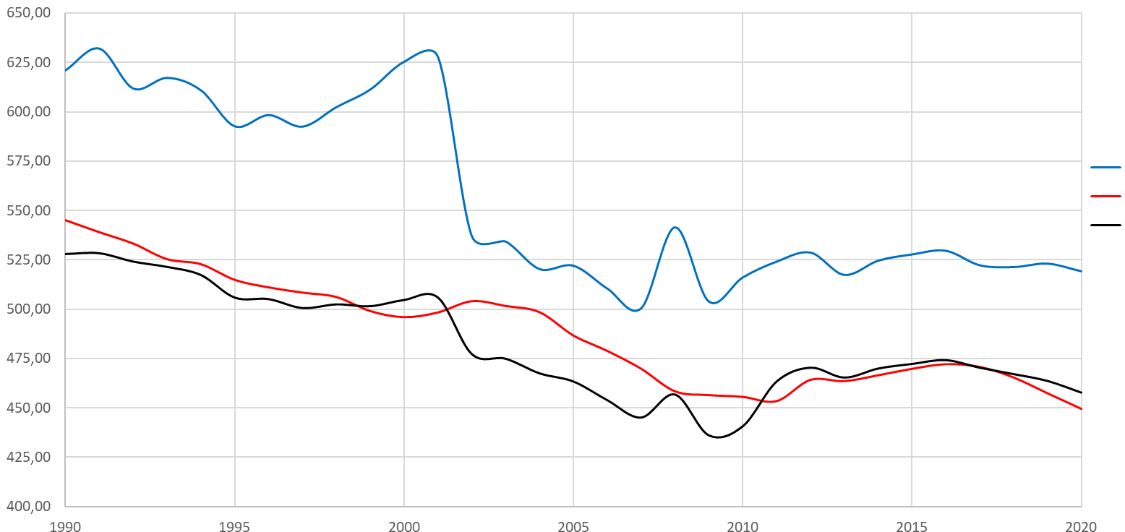
Indicator 7 : Water availability per capita
Average annual water availability per capita (m³/capita/year) at the national level.
4o mini
Evolution of water availability per capita (m³/capita/year) by Mediterranean shore, from 1990 to 2020.
Northern shore
Southern shore
Water availability per capita (m³ per capita per year)
4o
Mediterranean
Regional decrease in water availability per capita over the period from 1990 to 2020 (-13.3%), with significant disparities between the two shores.
The Southern shore has experienced a more drastic decrease in water availability per capita compared to the Northern shore, with countries registering negative variations over the covered period (-30% for Morocco, -23.5% for Egypt, -42.7% for France).
Source: FAO AQUASTAT, 2024

Slide 12
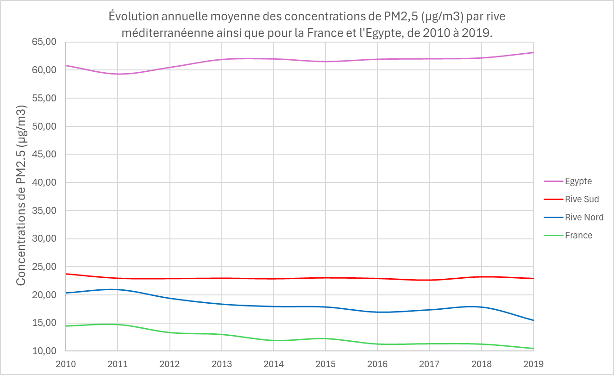
Indicator 8 : Air quality
Annual average atmospheric concentrations of PM2.5 particles (diameter < 2.5 micrometers).
Annual average evolution of PM2.5 concentrations (µg/m³) by Mediterranean shore, as well as for France and Egypt, from 2010 to 2019.
Over the covered period, the Northern shore shows a clear decrease in PM2.5 concentrations, dropping from 20 µg/m³ in 2010 to 15 µg/m³ in 2019. This decline is less pronounced for the Southern shore (from 23.7 µg/m³ in 2010 to 23 µg/m³ in 2019).
Egypt stands out with PM2.5 concentrations two to three times higher than those of other Southern shore countries, highlighting the potential health impacts.
PM2.5 concentration (µg/m³)
4o
France
Northern shore
Southern
shore
France
Source: WHO, 2024.

Slide 13
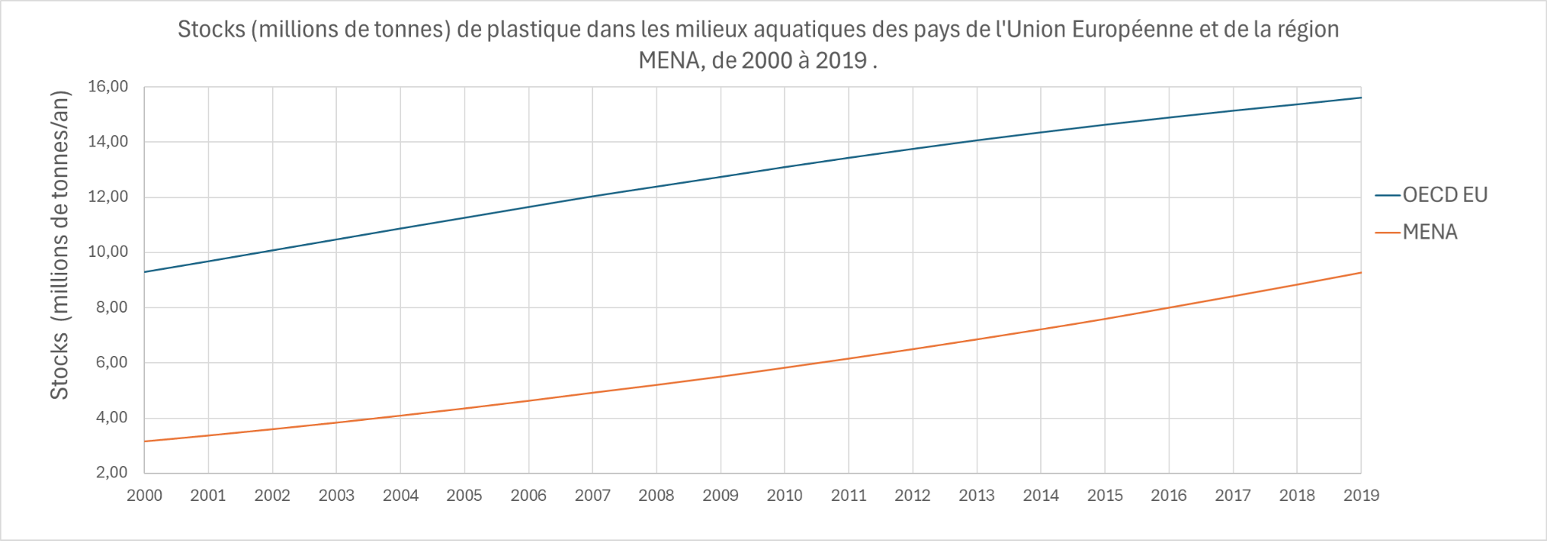
Indicator 9 : Plastic stock in aquatic environments (1/2)
Stocks (including various aquatic stocks) of plastic in millions of tons.
Plastic stocks (millions of tons) in aquatic environment of European Union countries and the MENA region, from 2000 to 2019.
Stocks ( Millions of tons per year )
Source: OECD, 2021.

Slide 14
Indicator 9 : Plastic stock in aquatic environments (2/2)
Stocks (including various aquatic stocks) of plastic in millions of tons.
Key Results :
Both regions show a concerning increase in plastic stocks in rivers, lakes, and associated marine environments.
Despite numerous regulatory frameworks and directives, plastic emissions continue to increase in the environment.
Precautions :
The concept of plastic is simplified here and presents a significant challenge to the scientific community, as well as to the monitoring and governance measures associated with it. Knowledge exists, but no database collects, characterizes, or evaluates the impact of plastic at the country level or across the Mediterranean.

Slide 15
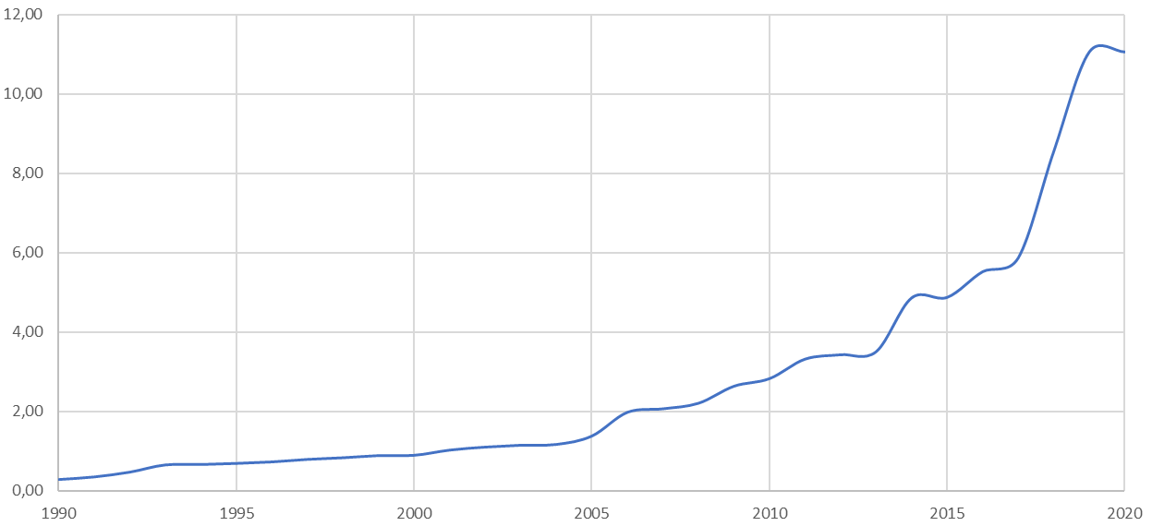
Indicator 10 : Protected marine areas (1/2)
Percentage (% of the total area of the Mediterranean waters) of coverage by Marine Protected Areas from 1990 to 2020.
Source: MAPAMED, 2022.

Slide 16
Indicator 10 : Protected marine areas (2/2)
Percentage (% of the total area of Mediterranean waters) covered by Marine Protected Areas.
Key Results :
Since 1990, the number of MPAs in the Mediterranean basin has increased significantly. In 2020, there were 1,278 MPAs, covering 11.05% of the region's marine area. However, this remains far below the 30% target set by Aichi Target 11 of the Convention on Biological Diversity (CBD), which was reaffirmed in 2022 during the COP15 of the CBD.
Additionally, 94% of the protected sites are located in the northern part of the Mediterranean. Furthermore, less than 0.1% of MPAs benefit from maximum protection, equivalent to that of a marine reserve.
Precautions :
The actual area of MPAs varies according to several factors: the delineation of its associated perimeter, its conservation status, its administrative boundaries, or the variations in the coastline.
Plan Bleu has chosen to represent the percentage of coverage (total area) of MPAs (excluding "unreported" MPAs by the data provider and MPAs shared between states, regions, or municipalities: double counting) from 1990 to 2020.

Slide 17
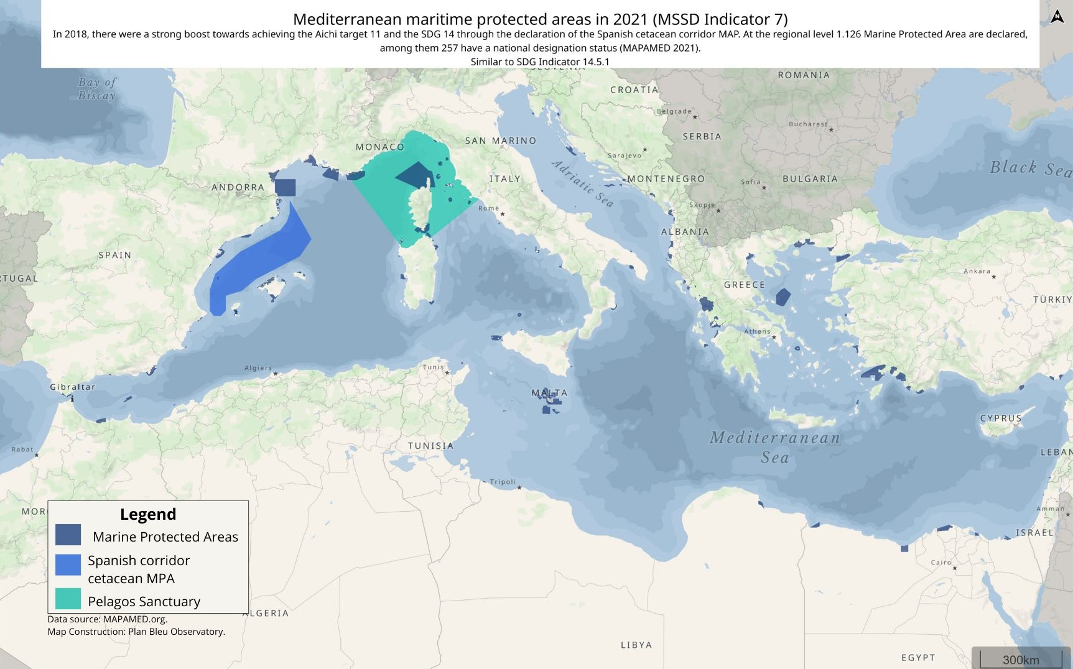

Slide 18
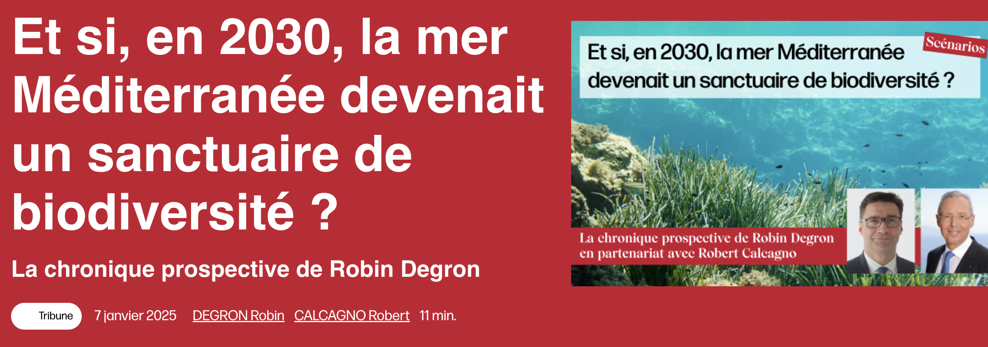
To go further on biodiversity issues

Slide 19

To go further on Environment&Health in Mediterranean region
🏺A new post Braudelian approach of Mediterranean sea and region, beyond 3 Times Of History Theory :
Toward 5 Times of Biosphera Theory
♻️ An indepth analysis of relationships between Climate Change, Great Water Cycle, Food Safety and Human Health
🔱 Some perspectives of actions raised during UNOC3 Summit, Nice 2025

Slide 20

Thank you
For your attention
Contacts :
rdegron@planbleu.org

