Slide 1

THE UNITED REPUBLIC OF TANZANIA
NATIONAL AUDIT OFFICE
Desertification Status in Tanzania
Reflection from a Performance Audit Report on the Implementation of the National Action Programme to Combat Desertification
Presented by James G. Pilly at the INTOSAI WGEA Plenary in Malta
Tuesday, 1 July 2025

Slide 2
Introduction
Country Desertification Status
Presentation Outline
Tanzania’s Efforts to Combat Desertification
Key Audit Findings
Impacts of Desertification in Tanzania
Conclusion

Slide 3
Introduction
In Tanzania, desertification is driven by poor land management, overgrazing, climate change, inefficient irrigation, and deforestation.
The Compendium of Best Practices for Sustainable Land Management (2014) and the State of the Environment Report (2019) indicate that around 75% of the country’s land is dry, with severe degradation in the regions of Dodoma, Shinyanga, and Simiyu.

Slide 4
1. Country Desertification Status
Tanzania faces significant desertification driven by land degradation, deforestation, drought, and water scarcity. This degradation poses a critical threat to national food security, economic stability, and community livelihoods.
Tanzania's forest cover has decreased steadily over a period of 11 years, from 2010 to 2021
Increased percentage of degraded land in Tanzania over several decades.

Slide 5
2. Tanzania’s Efforts to Combat Desertification
From 1997 when Tanzania ratified the UNCCD, efforts include;
National Land-Use framework Plan 2011-2031
Villagers guide for participatory planning and management of village land 2010
Preparation of the National Agricultural Land use Planning and Management Master Plan (2011)
Preparation and Implementation of the NAP to combat desertification 2014-2018
Guidelines for Mainstreaming NAP into Sectoral Policies, Plans and Programmes (2014)
Undertaking Project for Reducing Land Degradation on the Highlands of Kilimanjaro, Region
Mainstreaming Sustainable Forest Management in the Miombo Woodlands of Western Tanzania
Adaption of Different Strategies
Tanzania is a signatory to several multilateral agreements, including the United Nations Convention to Combat Desertification (UNCCD), the Convention on Biological Diversity (CBD), the United Nations Framework Convention on Climate Change (UNFCCC), and the African Convention on the Conservation of Nature and Natural Resources.

Slide 6
3. About the Audit
This audit was conducted to evaluate how effectively the Government of Tanzania through the Vice President’s Office (VPO) is addressing land degradation and desertification, in line with its commitments under the United Nations Convention to Combat Desertification (UNCCD).
The audit covered the period from 2015 to 2022, focusing on key ministries, agencies and Local Government Authorities (LGAs) responsible for implementing the National Action Plan (NAP).
Performance Audit Report on the Implementation of the National Action Programme to Combat Desertification (NAP)

Slide 7
Vice President’s Office and Sector Ministries lacked updated statistics on the country’s desertification status
Latest information available was up to 2022
PO-RALG and Ministries failed to implement 67% of planned NAP desertification activities.
Only 14 out of 21 activities were implemented
Inadequate Monitoring and Evaluation of the Implementation of the NAP to Combat Desertification
Monitoring Plans prepared by VPO, Sector Ministries and LGAs had unclear roles and responsibilities and lacked focus on NAPCD-related activities
MDAs and LGAs lacked KPIs and baseline data; and had undefined Targets for monitoring purposes
Inadequate Coordination for the Implementation of the National Action Programme to Combat Desertification
Insufficient reporting from implementing entities to the VPO
VPO provides limited feedback to Implementing Entities on the Status of NAP
4.
Audit Findings
The VPO did not adequately formulate the National Action Programme to combat desertification (NAP) due to lack of a clear, measurable baseline survey, limiting the program's ability to track progress and measure impact effectively.

Slide 8
6. Impacts of Desertification in Tanzania
Annual Loss of livestock across twelve (12) districts in Tanzania due to severe drought conditions (2022)

Slide 9
6. Impacts of Desertification in Tanzania
Decreasing trend of maize production in Tanzania

Slide 10
7. Audit Recommendations
Enhance NAP strategic planning by engaging stakeholders, allocating resources, and defining roles for coordinated implementation.
Promote inter- and intra-ministerial collaboration to support sustainable practices and reporting.
Develop an integrated data system with partners for accurate desertification data collection and dissemination.
Establish standardized M&E guidelines and a centralized system to monitor progress.
Ensure implementing institutions have detailed M&E plans covering objectives, indicators, methods, baseline data, reporting, resources, and risk management.
Evaluate the program’s overall effectiveness, sustainability, and impact.
VPO

Slide 11

8. Conclusion
The audit recognizes the Vice President’s Office (VPO) for its initiatives against desertification, including developing the National Action Programme (NAP) and securing international funding.
However, the VPO’s management of NAP is inadequate due to limited community engagement, poor coordination, insufficient land management, and lack of monitoring and evaluation frameworks. These shortcomings hinder the program’s effectiveness in combating desertification and achieving sustainable outcomes.
Supreme Audit Institutions (SAIs) play a vital role in combating desertification by auditing land degradation and policy effectiveness. Their evidence-based recommendations enhance land management and accountability, supporting environmental sustainability, climate resilience, and improved livelihoods in affected regions.

Slide 12
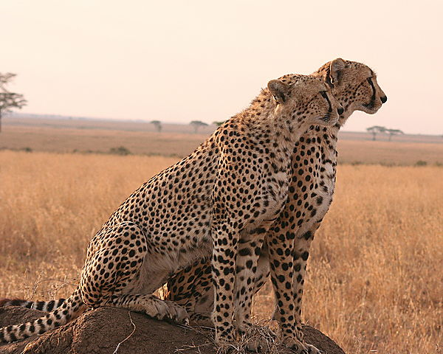
Serengeti National Park – Tanzania
Thanks!!
Asanteni!!

